Slide 1
Building the Vehicle Frame
William Shih, Deputy Race Director

Slide 2
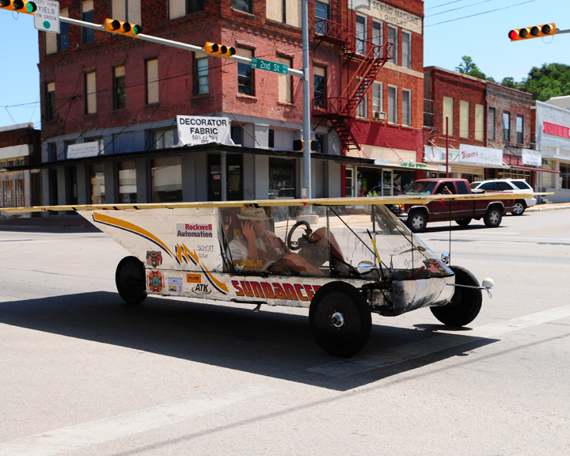
Building the Vehicle Frame
Materials
Roll bar and Crush Zones
Suspension and Steering
Wheels and Brakes

Slide 3
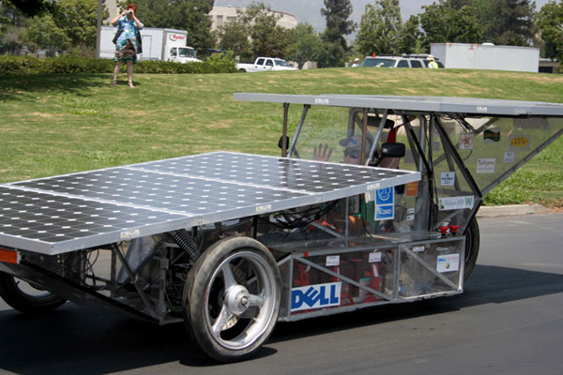
Material for the frame
Mild/Carbon Steel
Really easy to work with (MIG welding)
Inexpensive (<$1/foot)
Heavy
Can be easily changed/modified
Readily accessible
Comes in a large variety of sizes and wall thicknesses

Slide 4
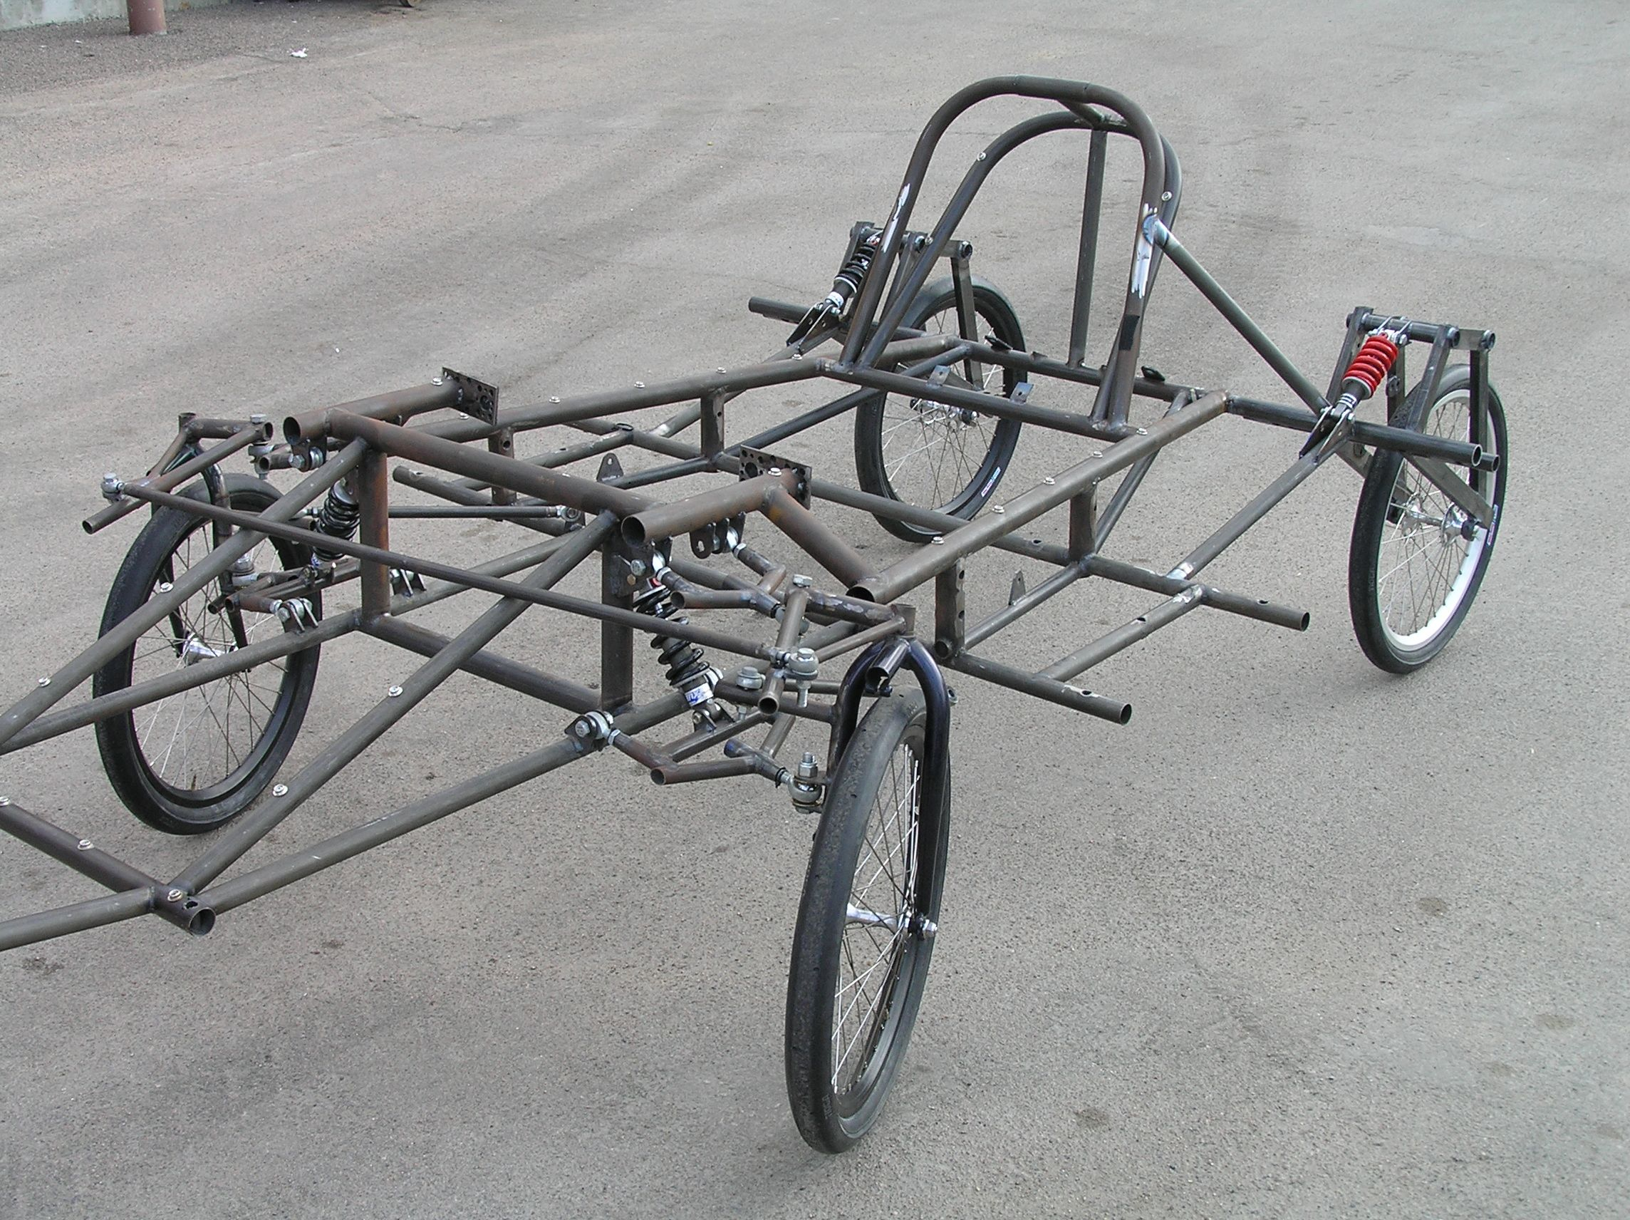
Material for the frame
Chromoly Steel
More expensive ($4/foot) (+welding wire @ $15/lb)
Light weight
Can be easily changed/modified
Comes in a large variety of sizes and wall thicknesses

Slide 5
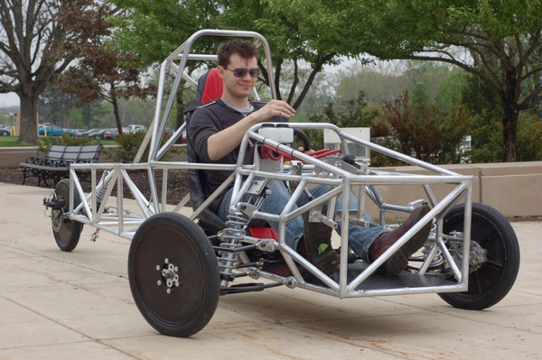
Material for the frame
Aluminum
Very stiff for its weight
Harder to weld (TIG)
Generally tubular; notch to get better fit
Needs more material to resist fatigue
Can be difficult to repair

Slide 6
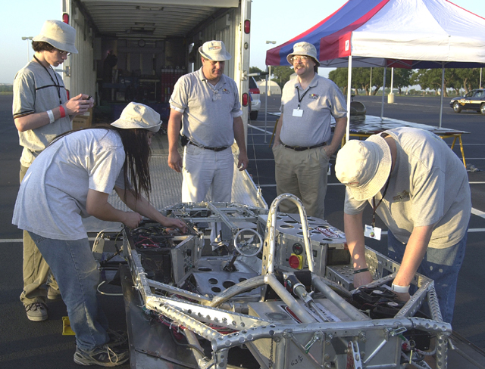
Material for the frame
Titanium
Light
Strong (but not stiff)
Absorbs shock
Hard to weld
Expensive
Limited sizes

Slide 7
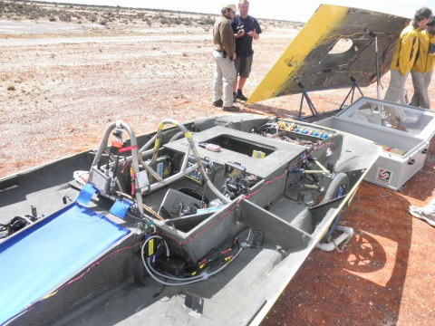
Material for the frame
Carbon Fiber (composites)
Lightest and stiffest
Can be formed to any shape
Expensive
Needs careful planning
Learning curve is steep
Very hard to repair on the side of the road
Need professional engineer certification if used for roll cage, roll bar, or crush zone

Slide 8
Building the Vehicle Frame
Materials
Roll bar and Crush Zones
Suspension and Steering
Wheels and Brakes

Slide 9
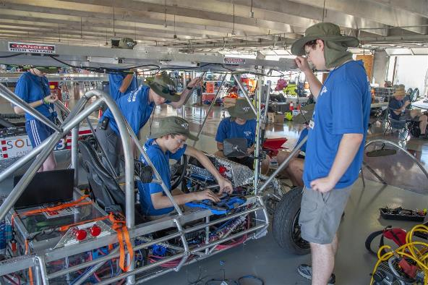
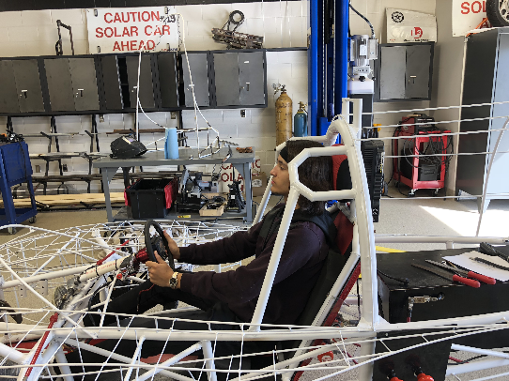
Roll Cage, Crush Zone, Roll Bar
Roll Cage – rigid protection encompassing entire driver; minimum OD of 1.9cm; minimum 5cm clearance to driver
Crush Zone – structural components designed to collapse on impact; minimum 15cm clearance to driver; minimum coverage
Roll Bar – protects driver in event of rollover; continuous piece of metal; minimum 5cm vertical clearance; minimum OD of 5cm; minimum wall thickness based on material; welded to frame

Slide 10
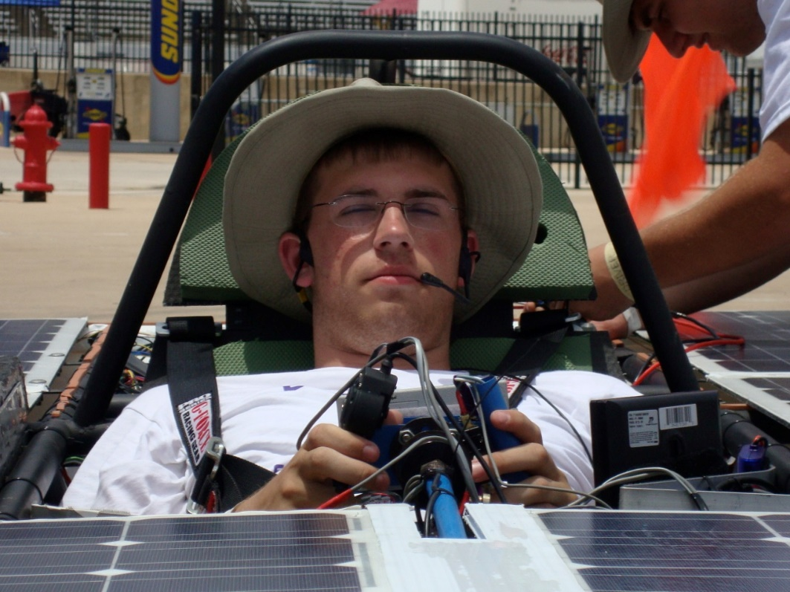
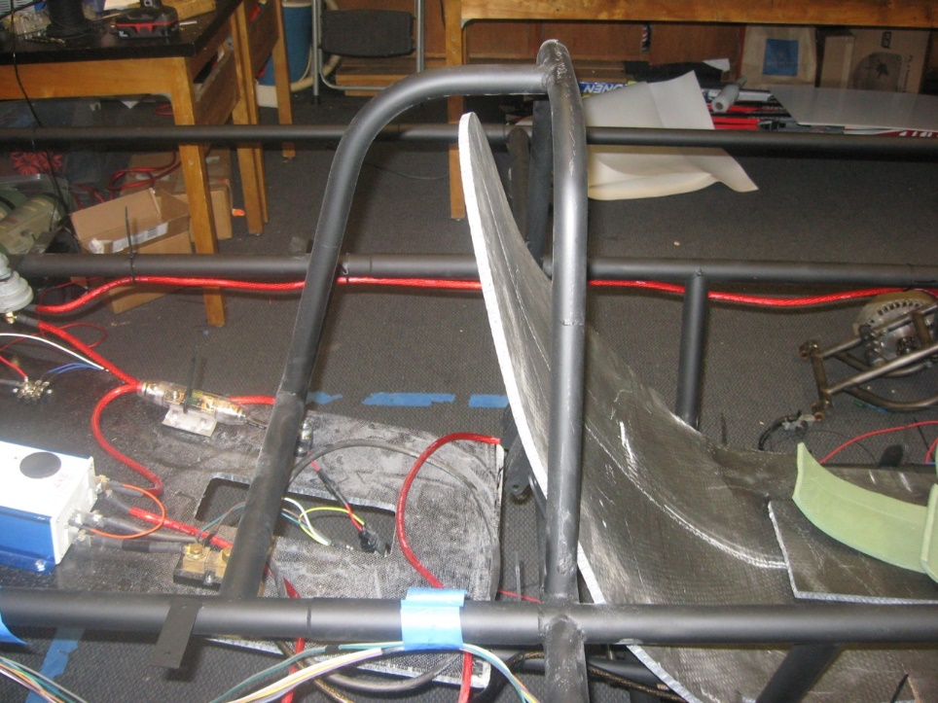
Roll Bar Example
Sufficient vertical clearance
Continuous piece of metal
Side View
Front View

Slide 11
Crush Zone
Crush zone must:
be designed to absorb impact from a collision
protect the driver from front, side, and rear collisions
have a minimum of 15 cm of horizontal distance from all parts of the driver’s body
Teams must be able to demonstrate a specific, adequate crush zone in order to compete. Insufficient regard for structural safety will result in disqualification.

Slide 12
Crush Zone Structure

Slide 13
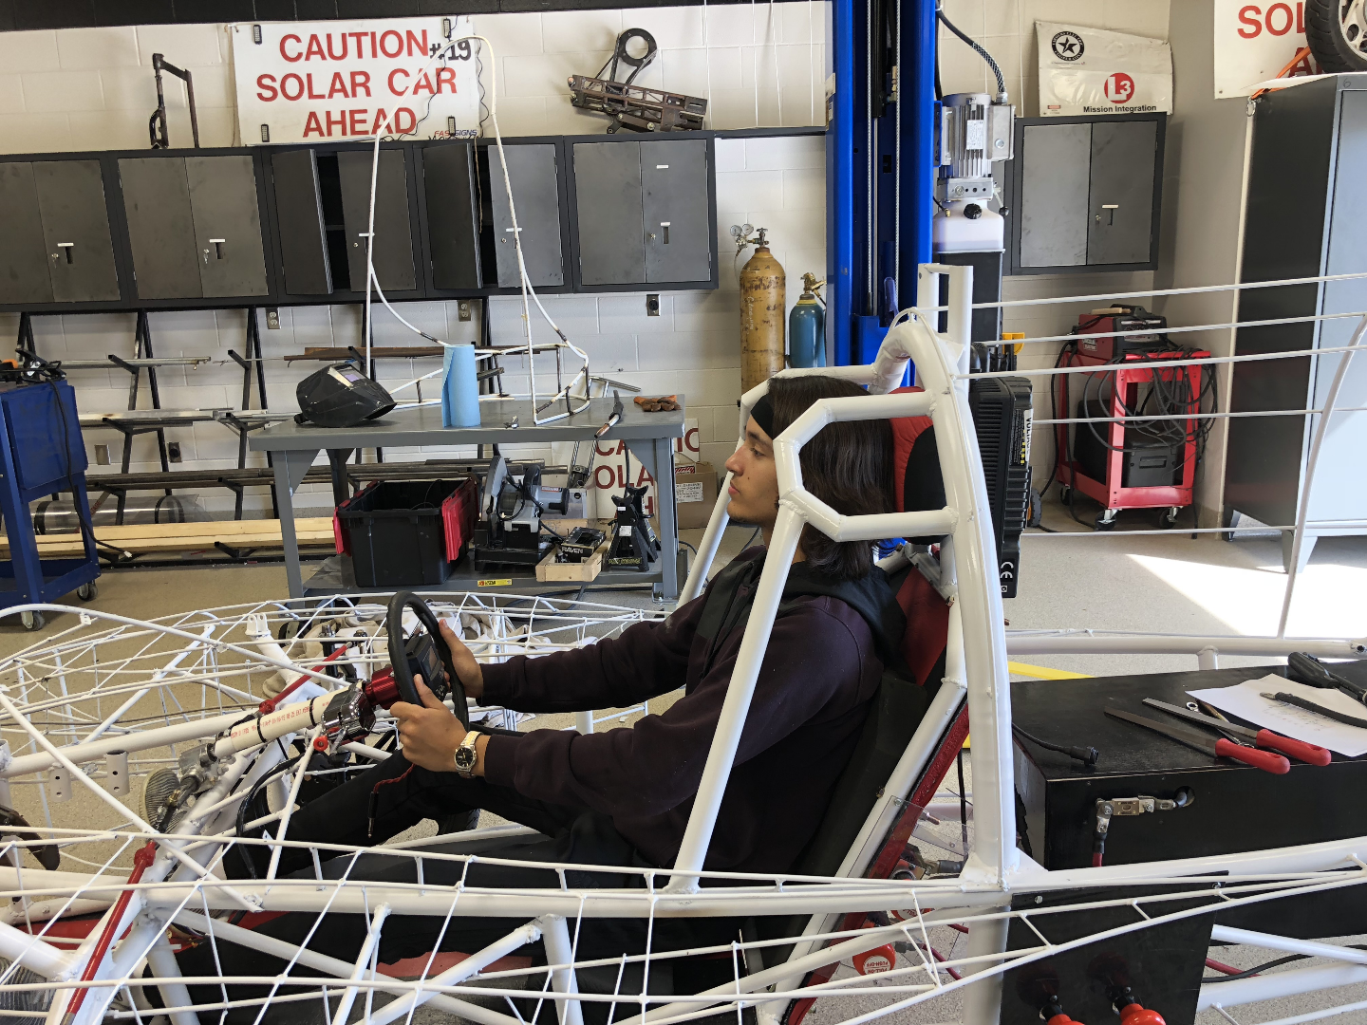
Roll Cage / Roll Bar / Crush Zone Example
Roll Bar – continuous piece of metal; protects driver in event of rollover
Crush Zone structure – thin material designed to collapse on impact
Roll Cage – rigid protection encompassing entire driver

Slide 14
Roll Cage / Crush Zone Example
Crush Zone – would prefer structure less rigid and deflect away from driver
Roll Cage – good use of strong structural components; may need additional coverage for driver torso

Slide 15
Building the Vehicle Frame
Materials
Roll bar and Crush Zones
Suspension and Steering
Wheels and Brakes

Slide 16
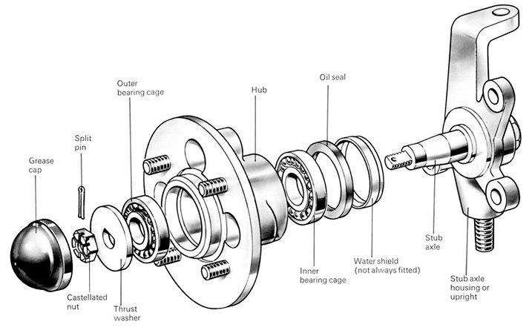
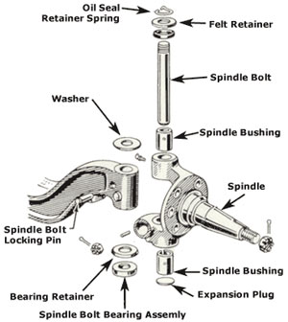
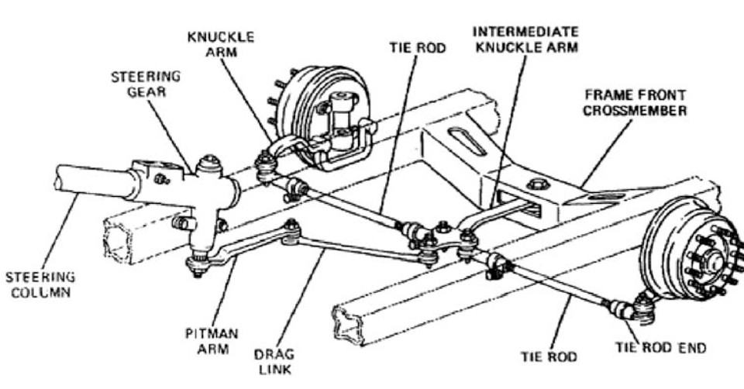
Suspension Components
Hub
Spindle
Axle
Tie Rod

Slide 17
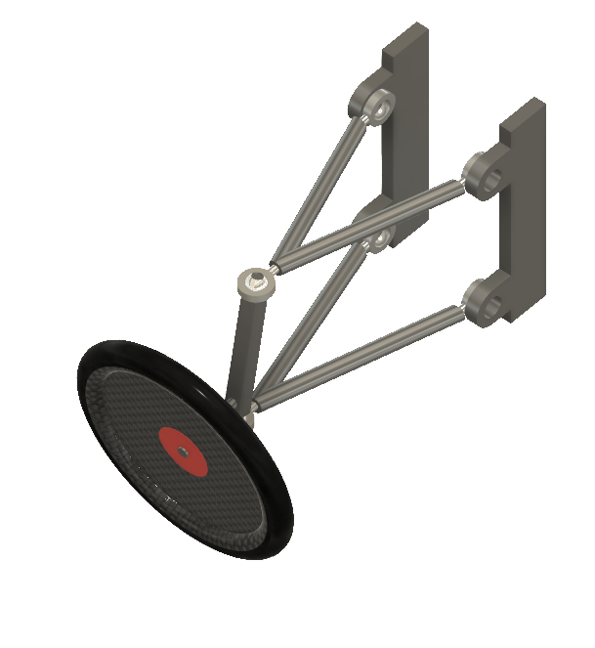
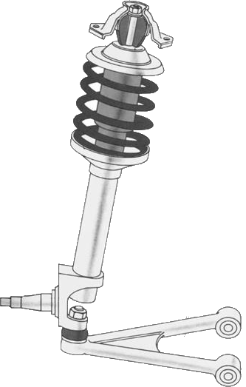
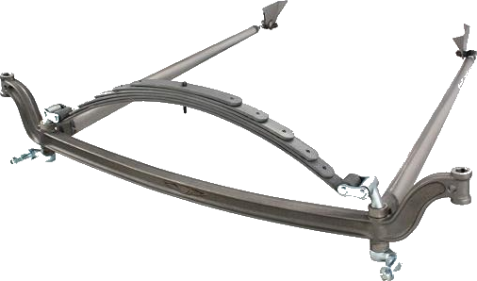
Common Front Suspension Types
MacPherson Strut
Solid Axle
Dual A Arm
Notes:
MacPherson
-production vehicles
-tend to be heavy
-limited adjustability
Solid Axles
-simple
-geometry is set at construction
-can be heavy
Double Arm
-most popular
-very versatile
-can be complicated with lots of options and area for mistakes

Slide 18
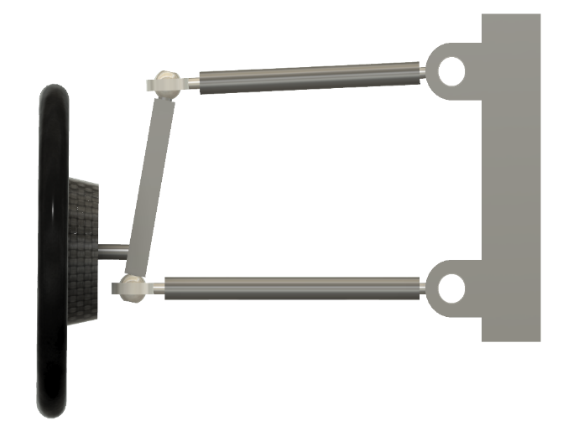
Suspension/Steering Considerations
Contact Patch
Oval shaped area where tire contacts the road
Steering Axis
Line between two pivot points of the wheel
Side
Top
Side
Top
Ideal
Real

Slide 19
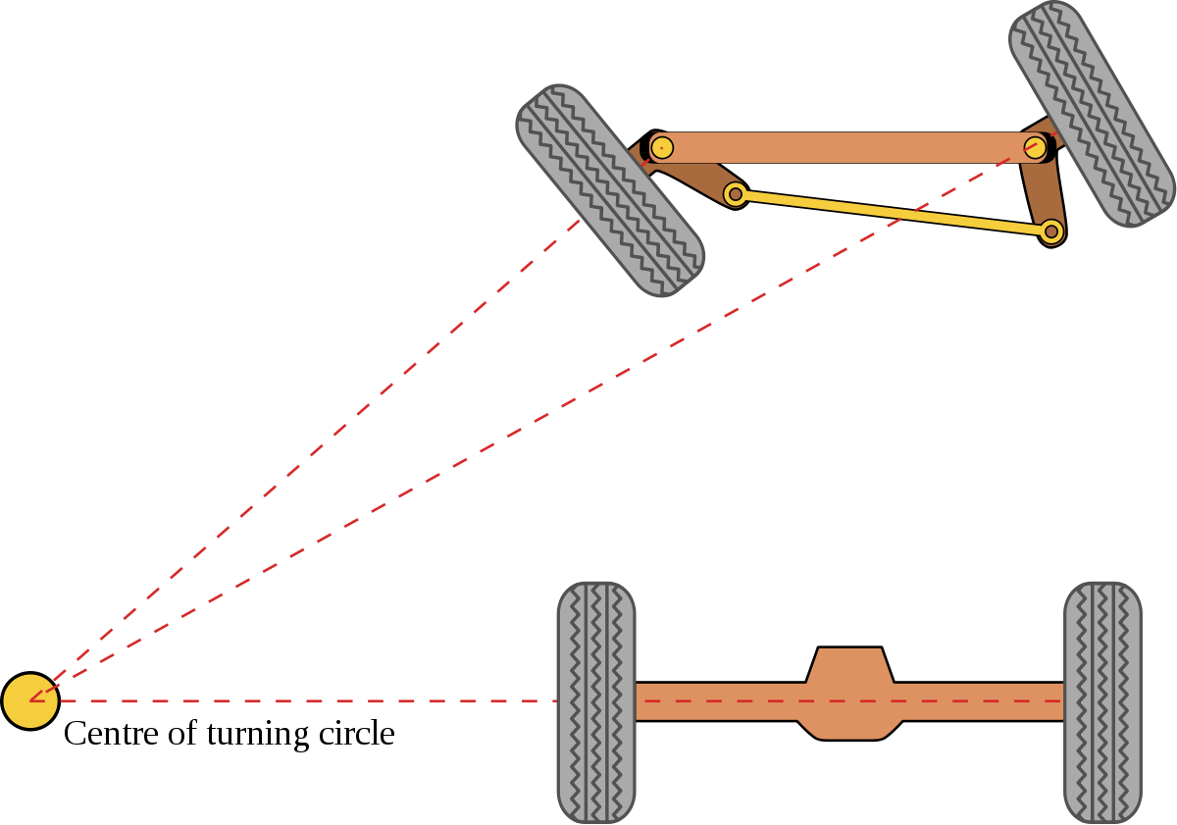
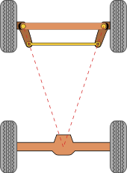
Ackerman Steering

Slide 20
Steering Geometry
Toe
Angle of the wheel and tire pointing away from the centerline of the vehicle
Caster
The angular displacement of the steering angle for the vertical axis
Camber
The angle of the wheel and tire with respect to the vertical axis
Scrub Radius
The distance between where the steering angle intersects the ground and the contact patch of the tire

Slide 21
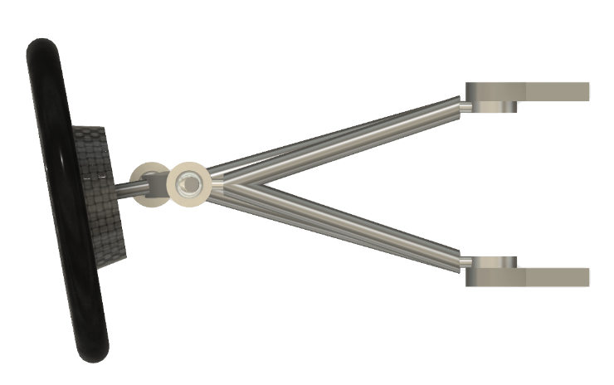
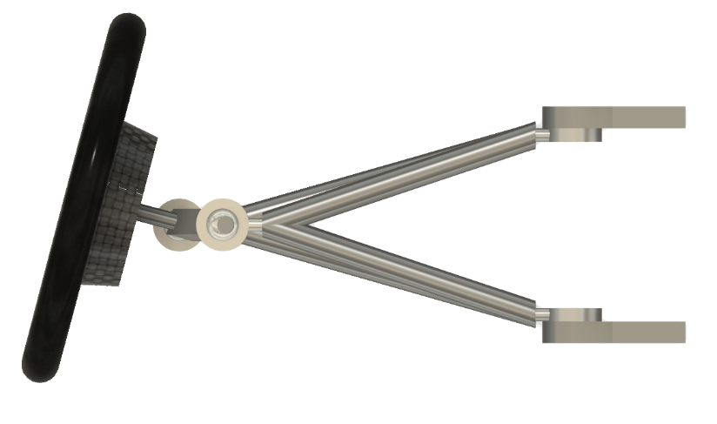
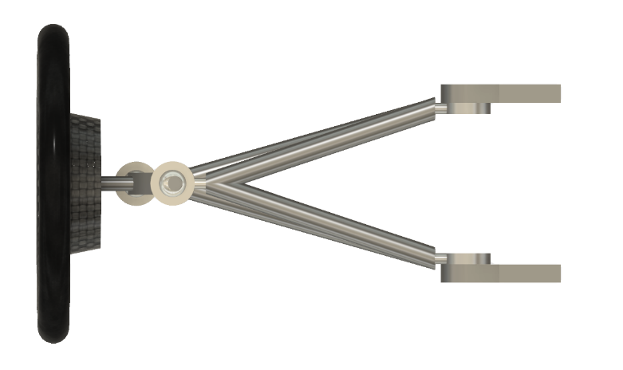
Toe Geometry
Center Line
Center Line
$$∅$$
Front
$$∅$$
Center Line
Neutral
In
Improves straight line stability
Out
Improves Steering Response
Can make steering “jerky”
Notes:
Toe
Affects Tire Wear: want to run straight down the road – if in/out, will drag
Solar cars – affected by use of thin tires (Bridgestone Ecopia)

Slide 22
Measuring Toe
Front
$$∅=\sin^{−1}\left(\frac{\frac{\left(Dist A−Dist B\right)}{2}}{Dist C}\right)$$
Dist A
A2
A1
$$Toe=\left(Dist A−Dist B\right)$$
Dist B
C
B1
B2
Notes:
How to do proper alignment
Measure at the same spot each time

Slide 23
Steering Geometry
Toe
Angle of the wheel and tire pointing away from the centerline of the vehicle
Caster
The angular displacement of the steering angle for the vertical axis
Camber
The angle of the wheel and tire with respect to the vertical axis
Scrub Radius
The distance between where the steering angle intersects the ground and the contact patch of the tire

Slide 24
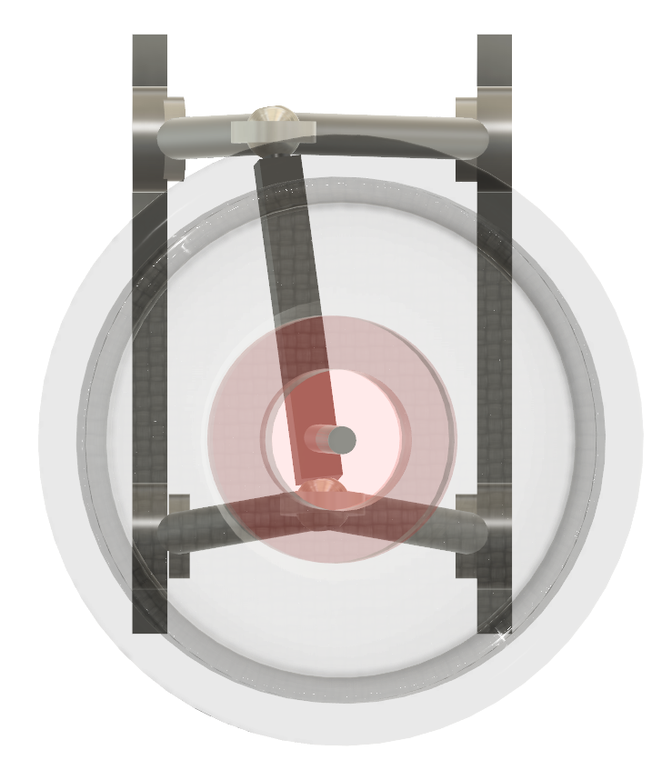
Caster
Vertical
Creates straight line stability
Positive Caster
Steering wheel feedback
Makes car harder to turn
Causes wheels to self center
Negative Caster
Unstable
θ
Front
Positive
Notes:
No correct answer; need to set it up for the driver

Slide 25
Steering Geometry
Toe
Angle of the wheel and tire pointing away from the centerline of the vehicle
Caster
The angular displacement of the steering angle for the vertical axis
Camber
The angle of the wheel and tire with respect to the vertical axis
Scrub Radius
The distance between where the steering angle intersects the ground and the contact patch of the tire

Slide 26
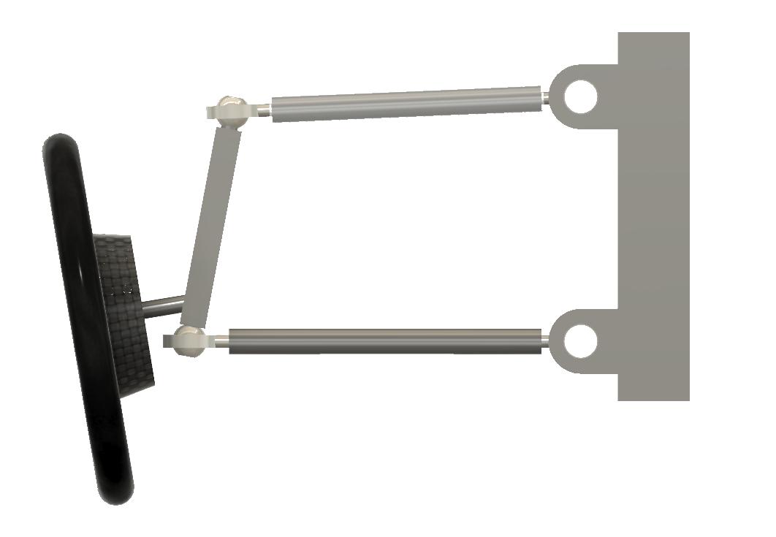
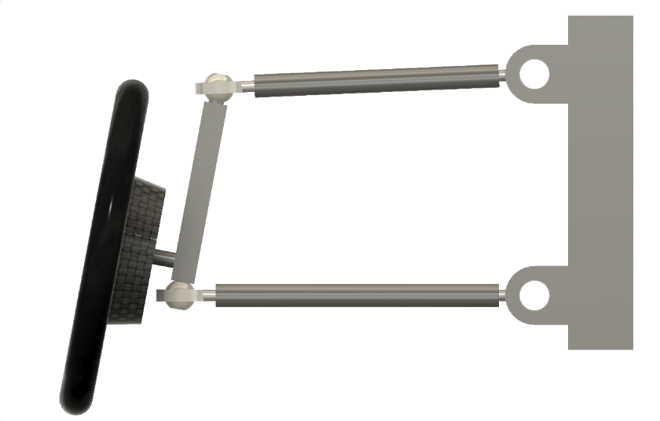
Camber
Vertical
Vertical
$$∅$$
$$∅$$
Front
Negative
Positive
Affects grip and stability in cornering
Not applicable to solar car racing
Notes:
Not applicable because we don’t have high speed cornering

Slide 27
Steering Geometry
Toe
Angle of the wheel and tire pointing away from the centerline of the vehicle
Caster
The angular displacement of the steering angle for the vertical axis
Camber
The angle of the wheel and tire with respect to the vertical axis
Scrub Radius
The distance between where the steering angle intersects the ground and the contact patch of the tire

Slide 28
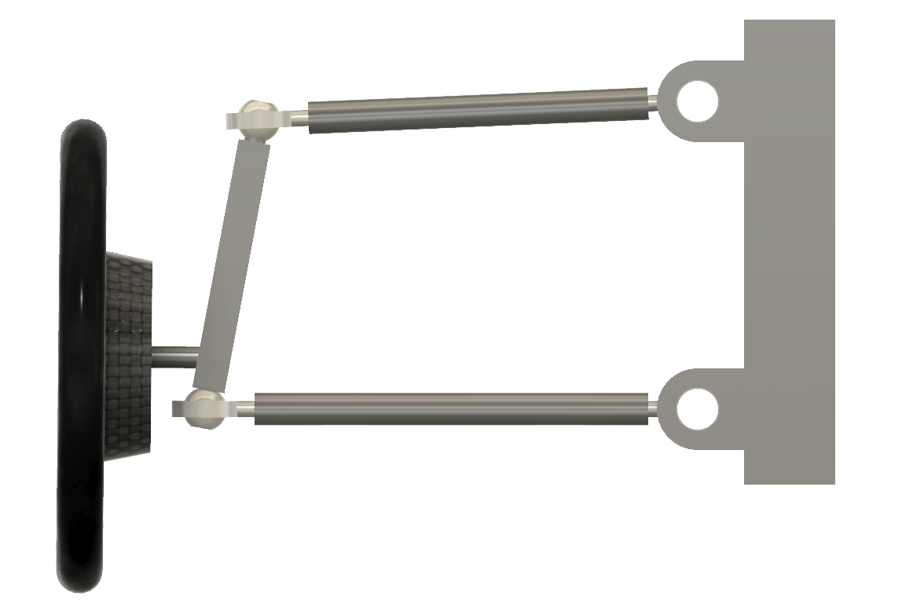
Scrub Radius
Coffee Cup Experiment
Harder to Turn
Increase wear on tire
Positive
Cause center seeking
Positive
Scrub Radius
Notes:
How much force/wear for turning
Coffee cup experiment – turn cup by turning on a point vs. turning using the handle
Minimize the scrub radius to lessen energy

Slide 29
Getting your car rolling
Building the Vehicle Frame
Materials
Roll bar and Crush Zones
Suspension and Steering
Wheels and Brakes

Slide 30
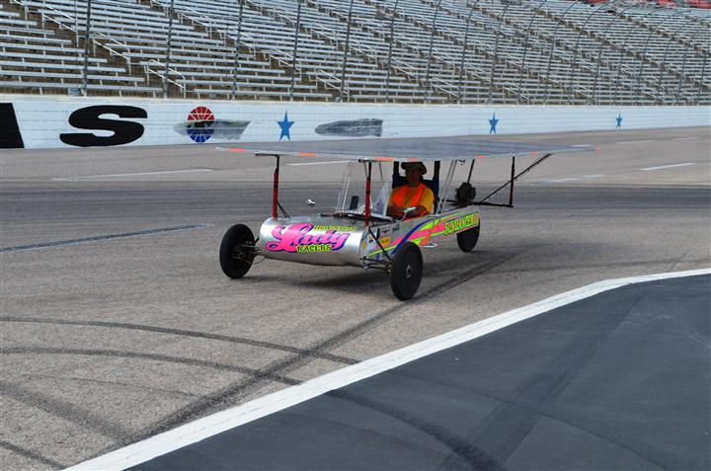
Wheels
One of the most difficult parts to source
Choices need to be made very early in the design process
Three wheel designs:
Lighter
Easier to align
Less expensive
Not as safe

Slide 31
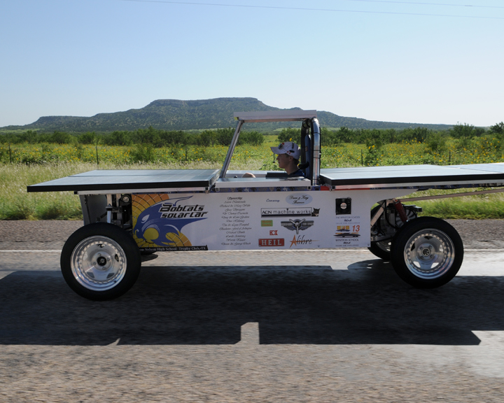
Wheels
Four wheel designs
More parts means higher cost
Harder to get alignment correct
Weight distribution less critical
Much safer in the event of a flat
Can “straddle” dead animals on the road
Required for Cruiser Division

Slide 32
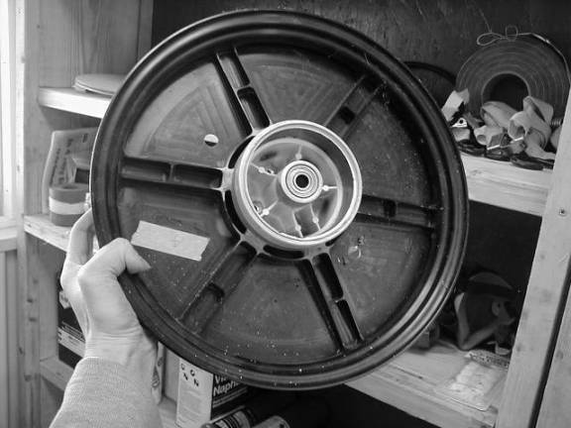
Wheels
Wheel choices (must be able to handle the weight of the car and lateral forces from turning)
NGM wheels and tires
Motorcycle
Junior Dragster
Bicycle

Slide 33
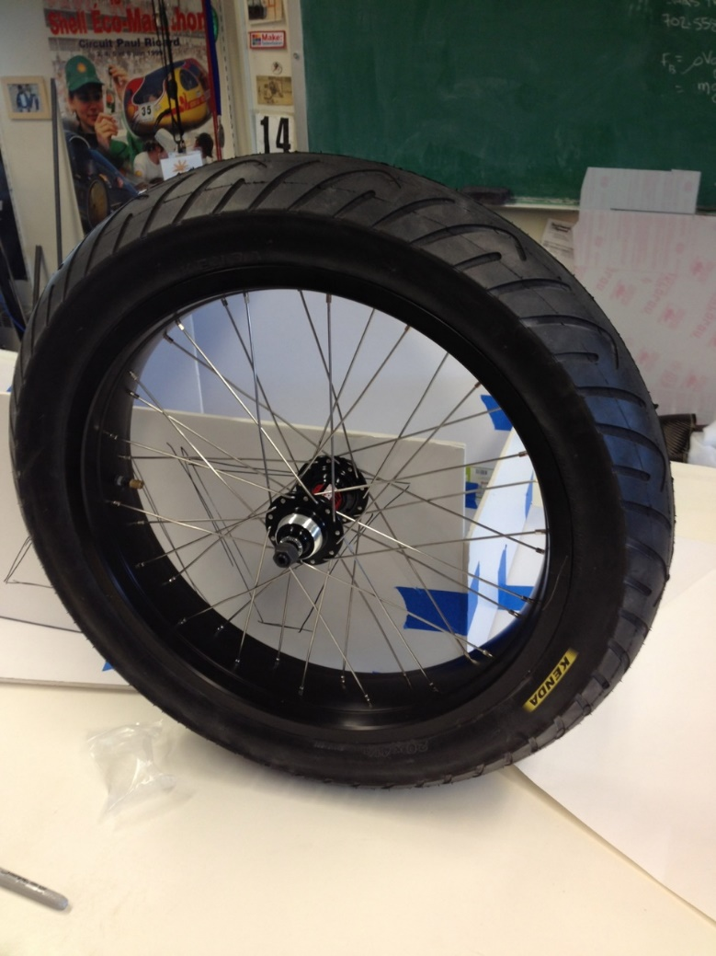
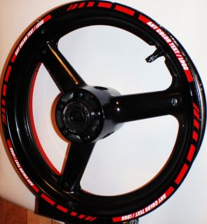
Wheels

Slide 34
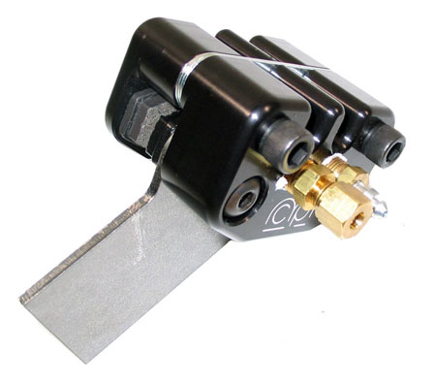
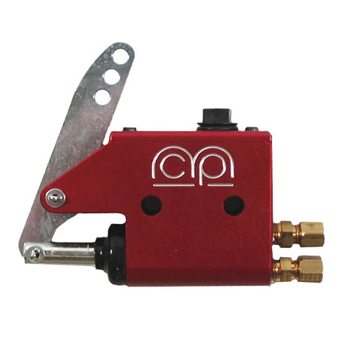
Brakes
Solar car must have two, independent, braking systems that allow the driver to stop the vehicle safely and quickly.
Most cars use hydraulic disk brakes
MCP single caliper brakes are easy to install and relatively inexpensive.

Slide 35
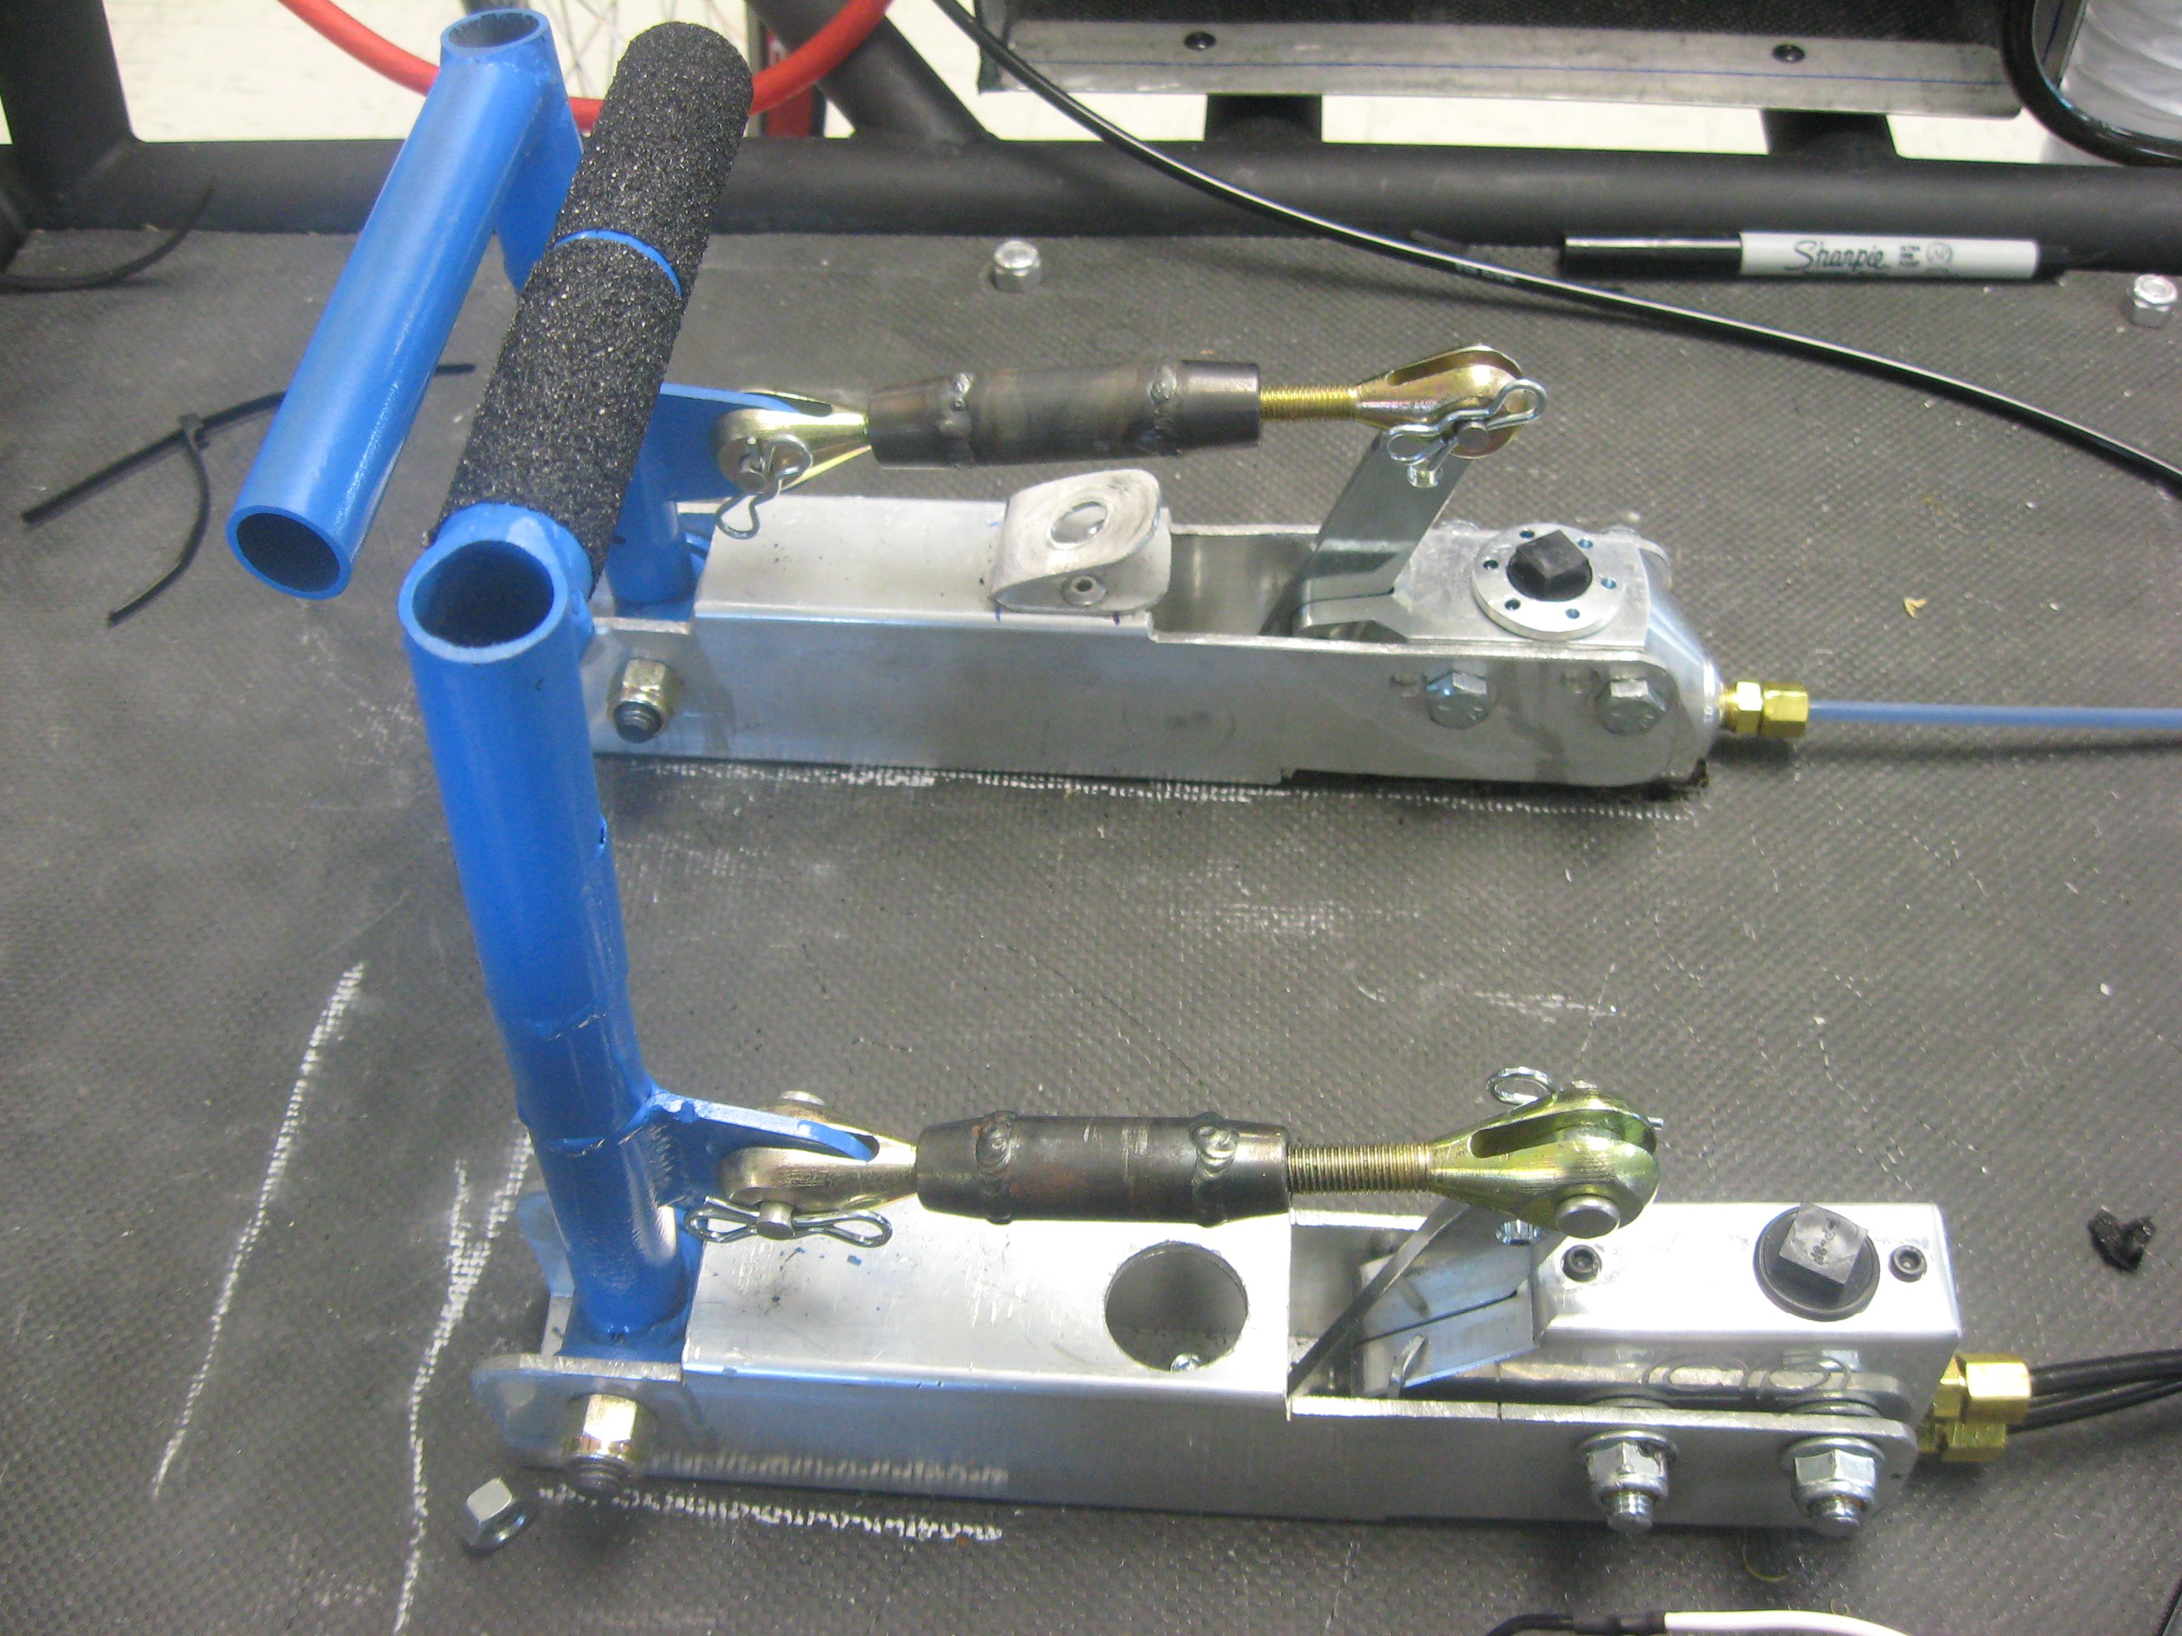
Brake Pedals
Brake pedals must also be independent
Pedals, master cylinder, etc. separate for each system
Can no longer “link” pedals together
New rules change for 2021-2022
Must be operated by foot (no hand brakes)
X

Slide 36
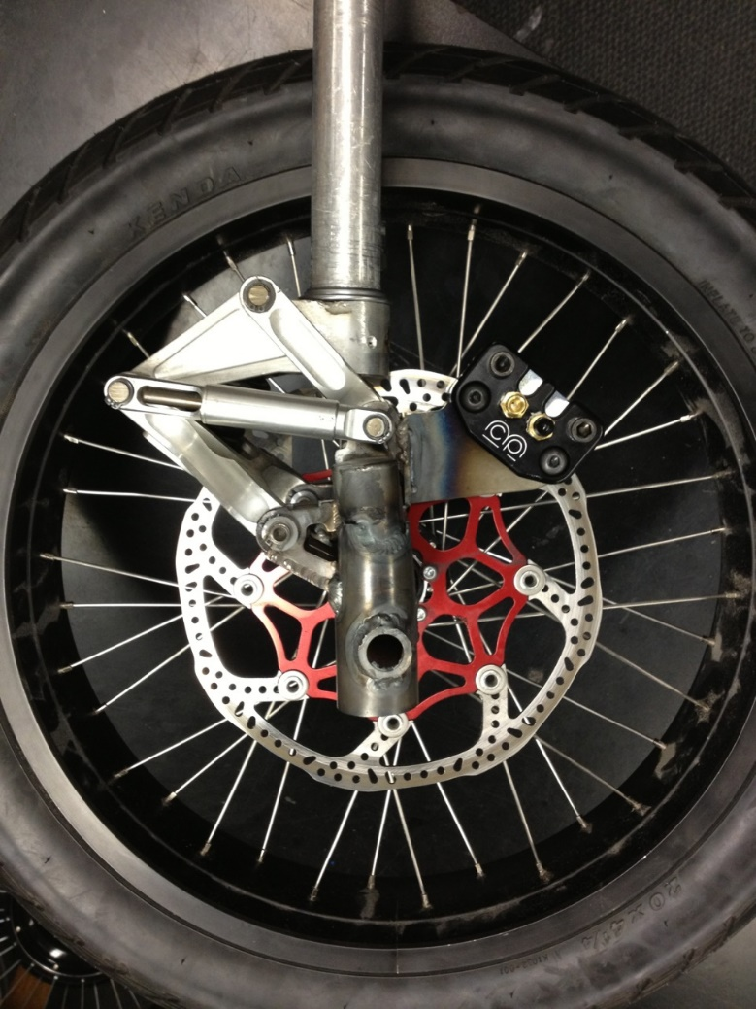
Brake Testing
Brakes are tested both statically and dynamically at the event.
Static = Test strength of brakes at rest
Dynamic = Test how fast brakes can stop car
Many vehicles have brake problems. Brakes must be tested before you arrive at the event!

Slide 37
Building the Vehicle Frame
William Shih, Deputy Race Director

