Slide 1
Specialty Workshop
Powering the Solar Car

Slide 2
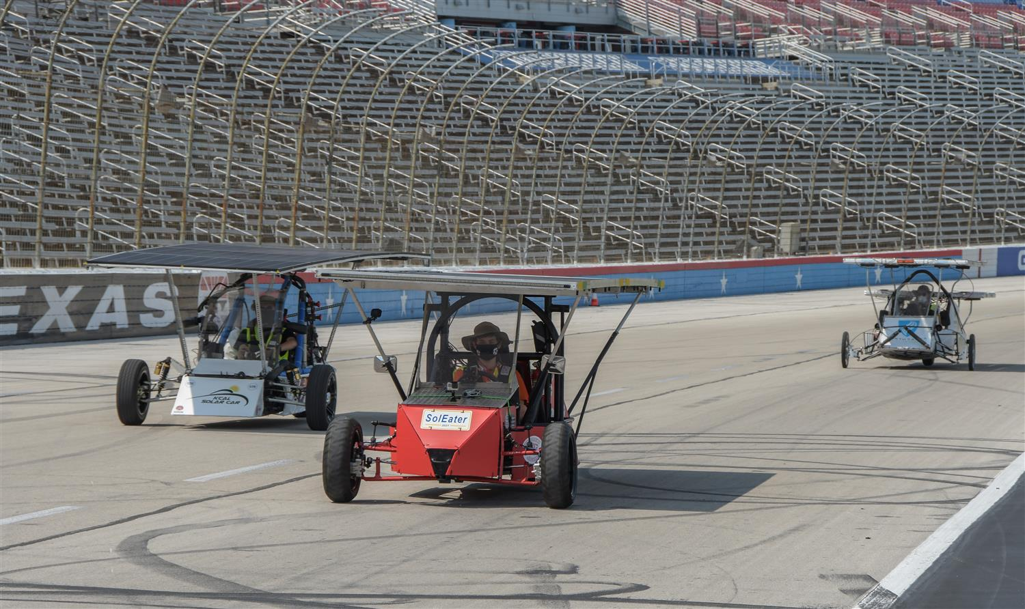
Powering the solar car
How do you get the car moving?
Photovoltaic array choices
Power trackers and DC-DC converters
Electric motors and controllers

Slide 3
Arrays

Slide 4
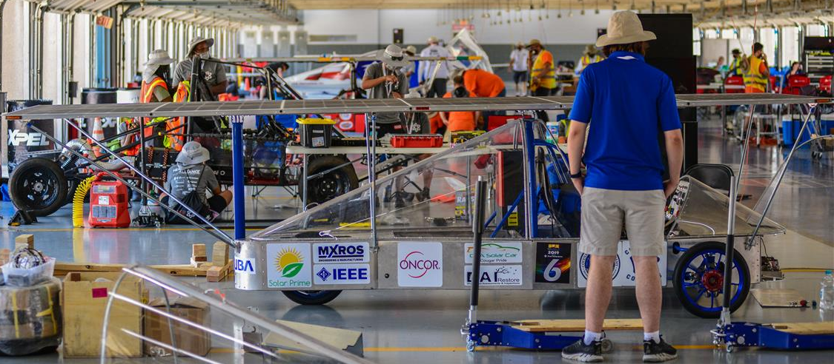
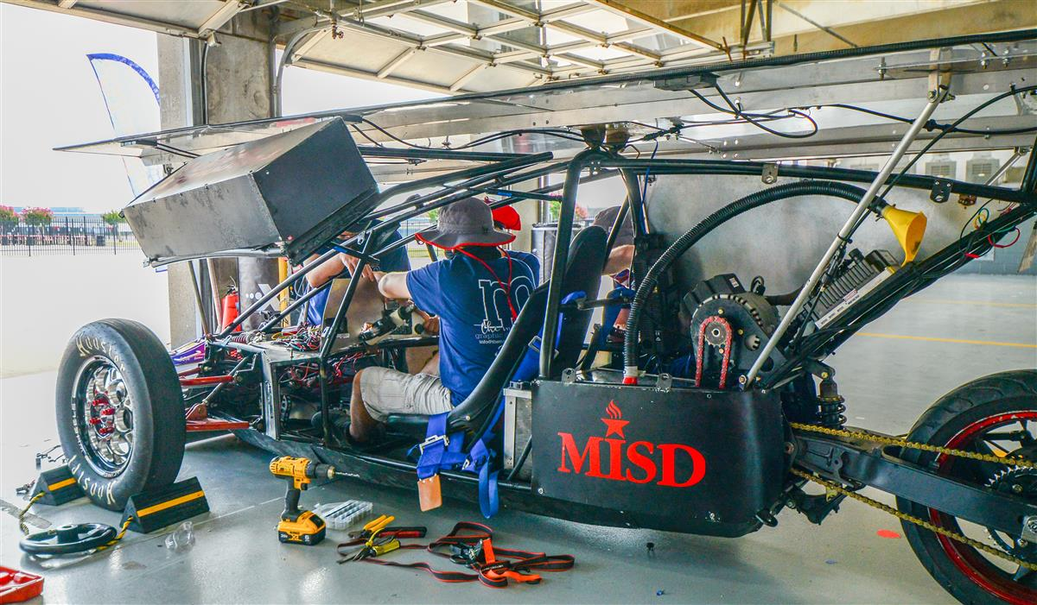
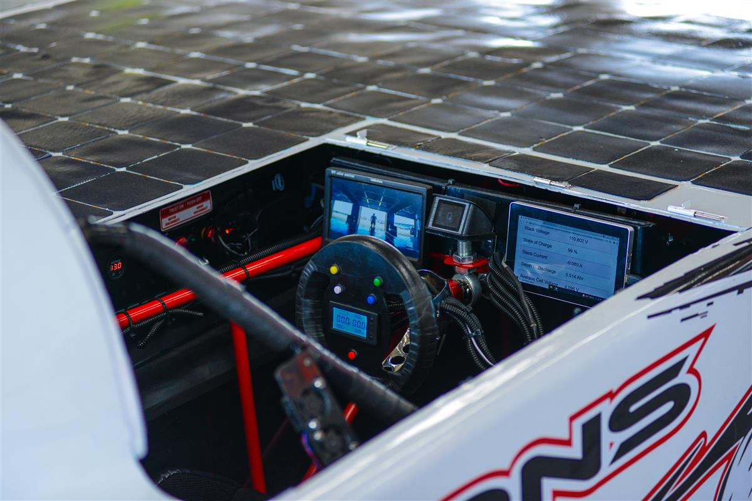
Substrate and Support Frame
Varies Depending on the Type of Array
Main Considerations
Rigidity
Cooling
Weight
Conductivity

Slide 5
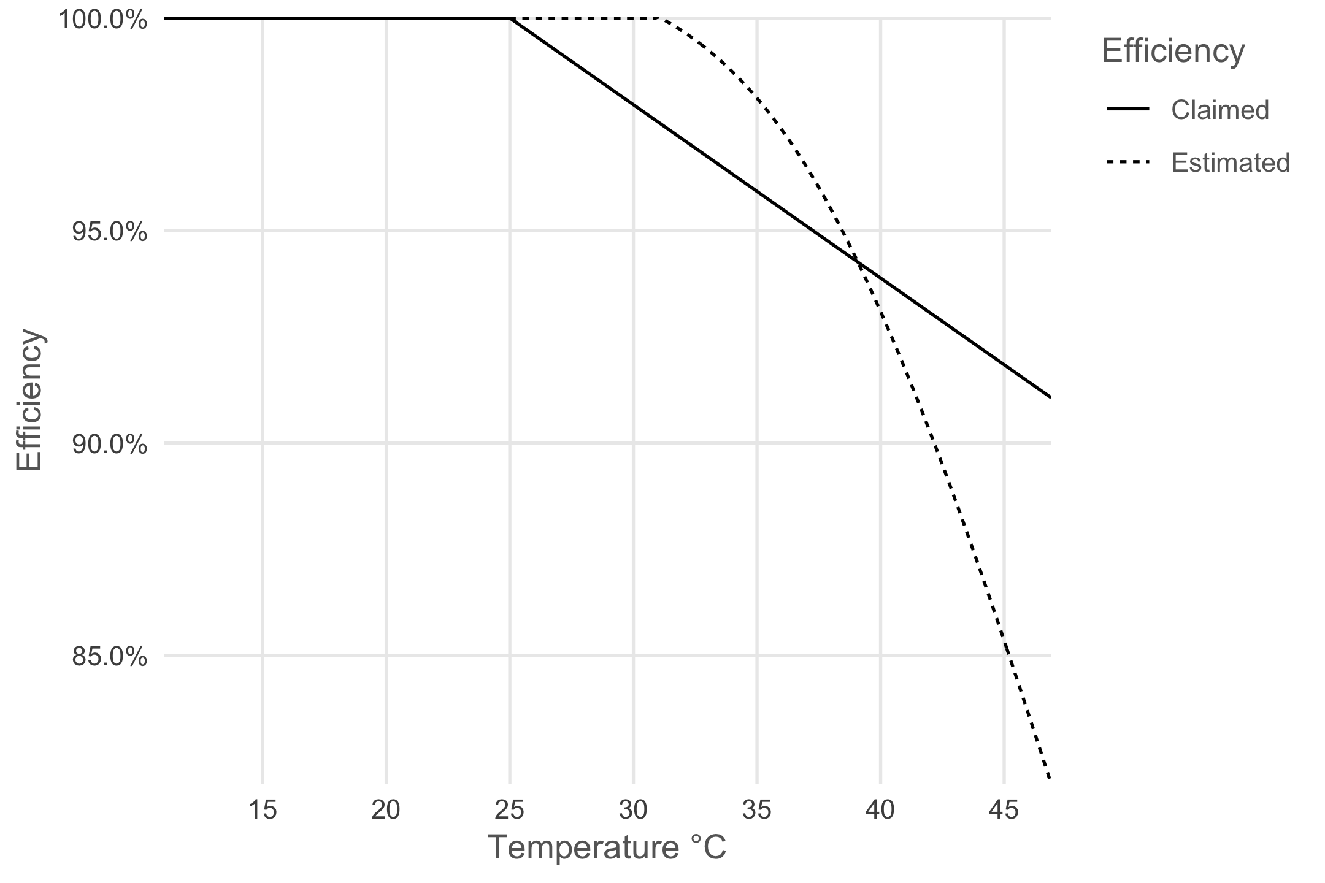
Panel Temperature
Solar Cells change efficiency as their temperature changes
https://www.jeroenboeye.com/blog/solar-panel-analysis-pt-2-temperature-and-efficiency/

Slide 6
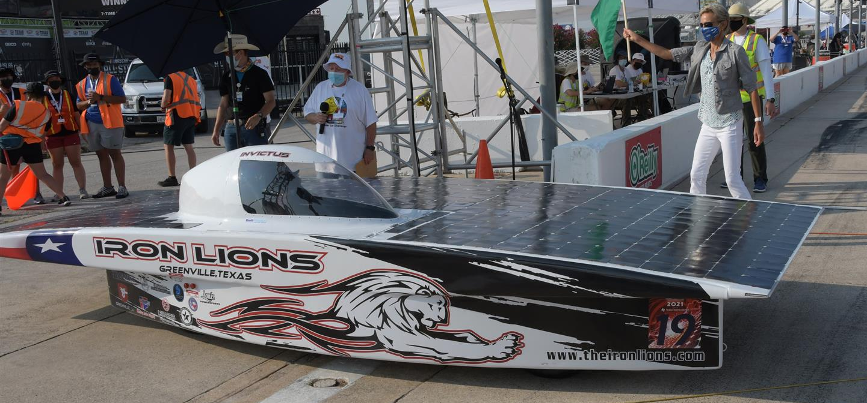
Shape of Array
Flat Solar Arrays
Easier to execute
Angle to sun less of a concern
Wing over body vs Canopy Above Array

Slide 7
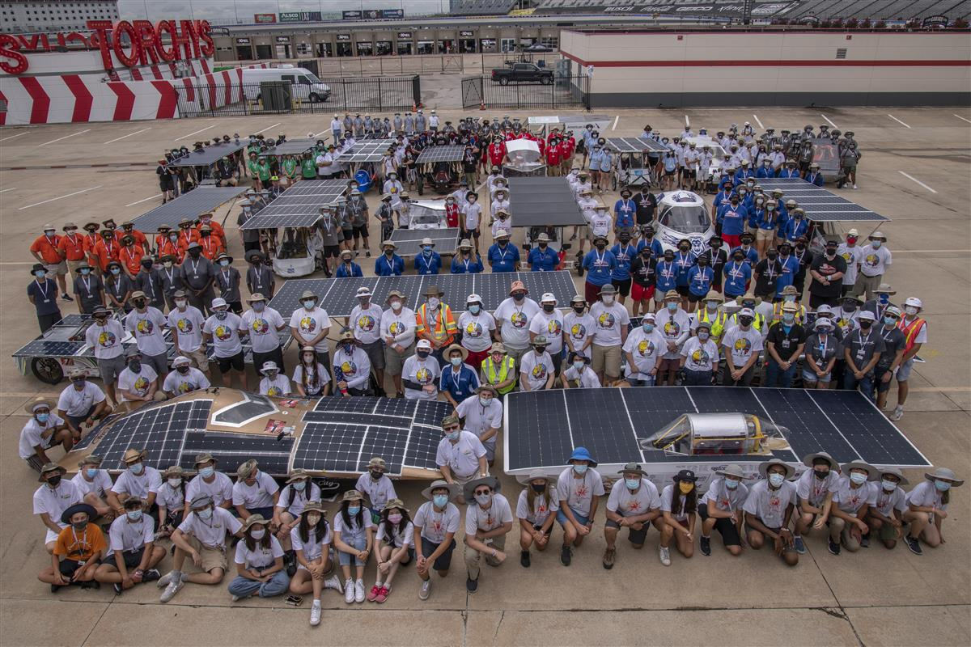
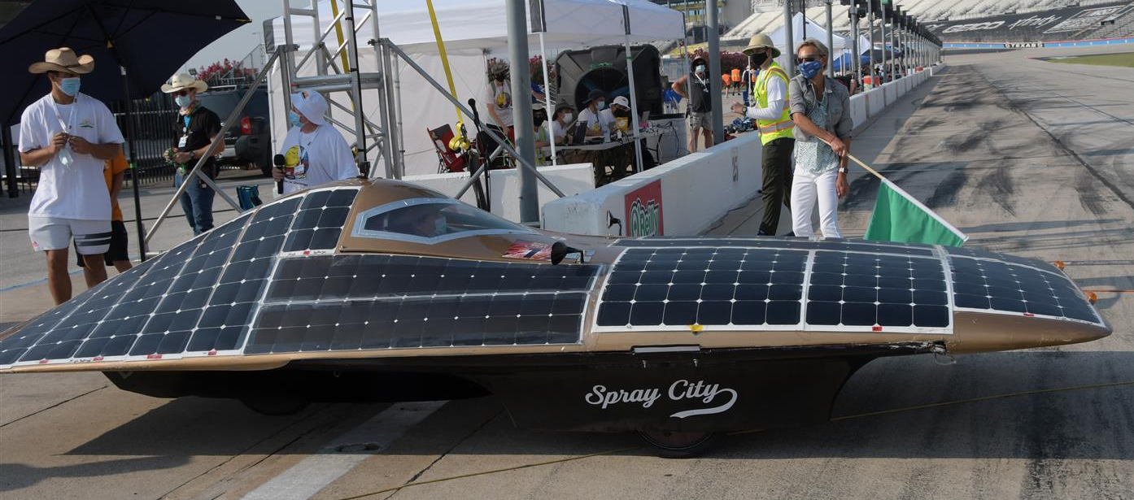
Shape of Array
Curved Solar Arrays
Higher the angle the greater chance for breaks without ideal support.
Angle to sun more of a concern

Slide 8
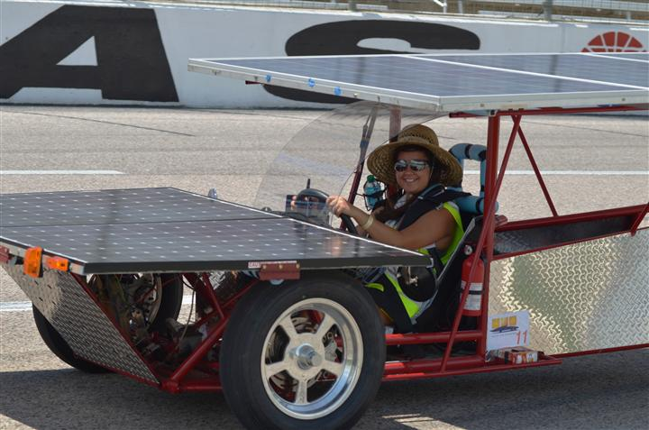
The Solar Array
Pre-made Commercial panels
Reliable
More Easily purchased
Typically HEAVY (glass top adds weight)

Slide 9
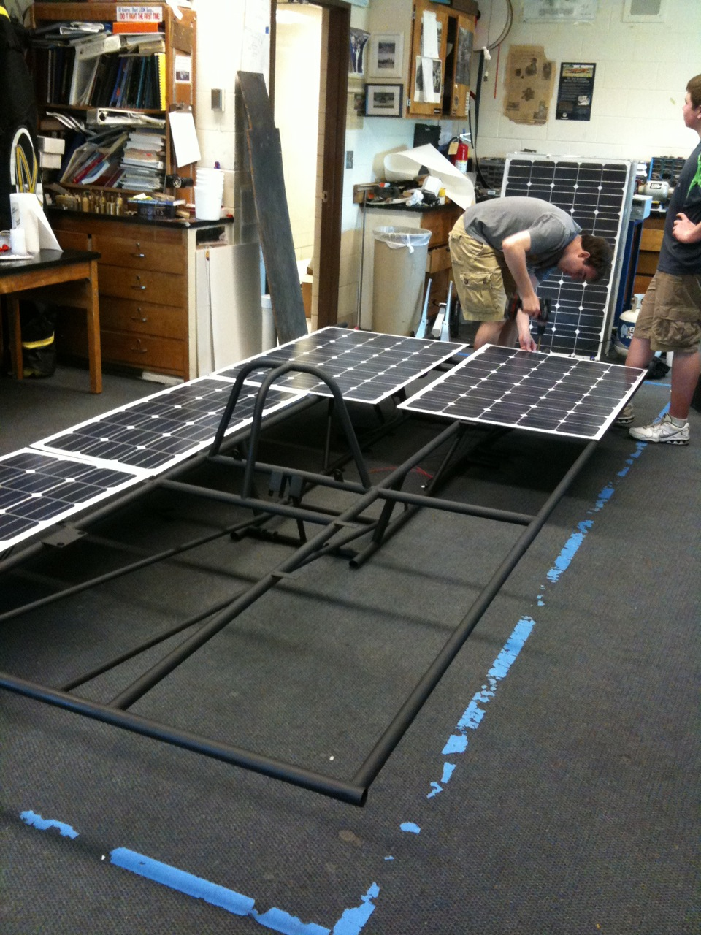
The Solar Array
Premade Lightweight Options
Many more on our website and online…

Slide 10
The Solar Array
Raw cells and lamination
Planning has to start FAR in advance (you are probably too late already!)
Process is expensive
Panels are very light and can be built to fit your car
Easy to maximize power and reduce aerodynamic drag
SunCat solar

Slide 11
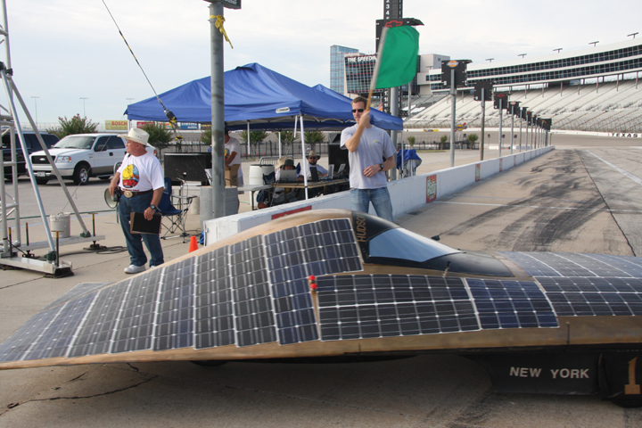
Laminated Cells

Slide 12
The Solar Array
Do-it-yourself solar array
Amazing learning experience
Learning curve is steep
Hard to find raw cells
Takes a lot of man power
Hard to watch when cells are continually breaking
Can fit exactly to your car

Slide 13
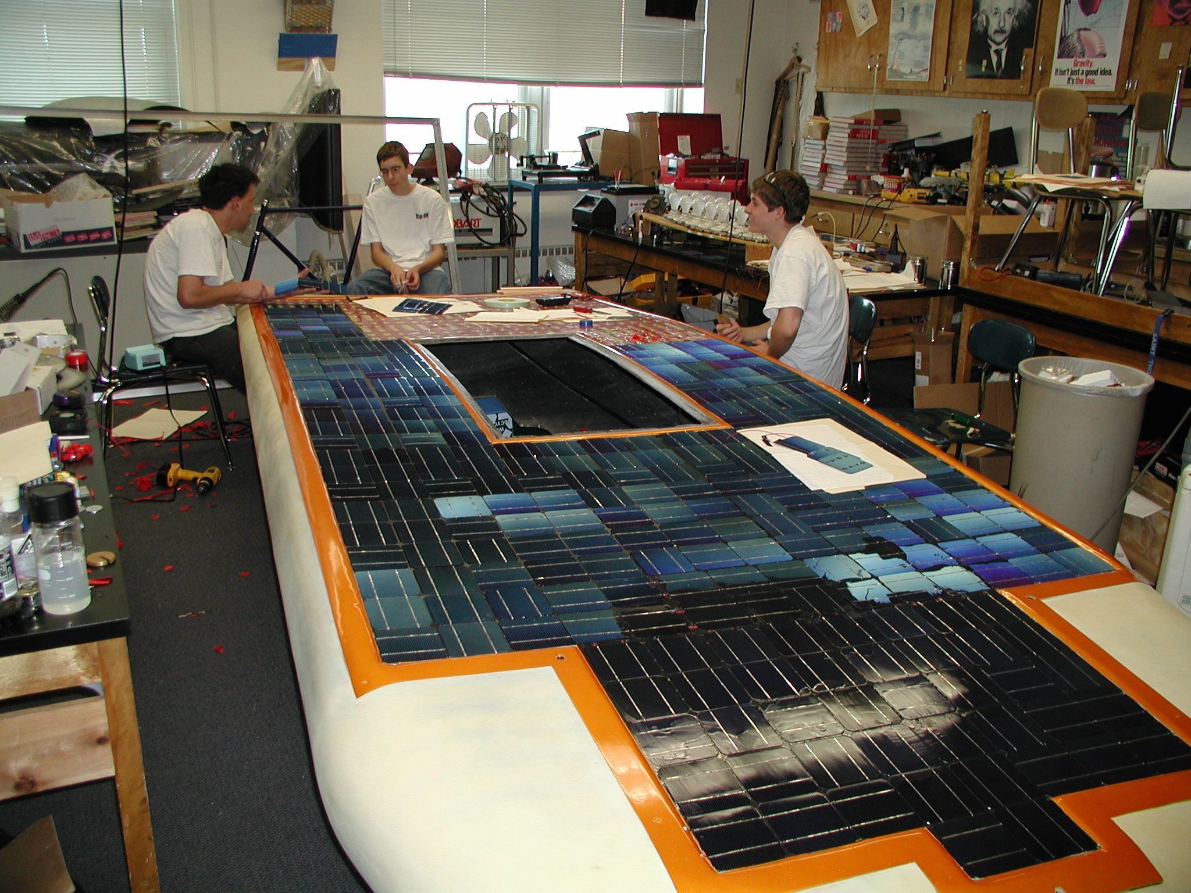
Do-it-yourself

Slide 14
Do-it-yourself

Slide 15
Power Trackers (MPPTs)

Slide 16
MPPTs and DC-DC Converters
Moving power from the solar array to the batteries is not as easy as hooking up a couple of wires!
Voltage from your solar array needs to match the voltage of the battery pack.
More often than not the group of solar panels will not match your system / pack voltage
Even if you do match the pack voltage it will not be efficient for charging your battery pack
Without protection you can have reverse current flow into the panels when they are shaded

Slide 17
What MPPTs Do
Maximum Power Point Trackers (MPPTs) adjust voltage and current from your array to give you the most efficient transfer of power to your vehicle
They adjust the output voltage of your array to always be at the right voltage for ideal charging of your battery
They can either “boost” voltage (40V to 72V) to a higher value or “buck” voltage (140V to 80V) to a lower value
MPPTs are also a main source of telemetry for your array

Slide 18
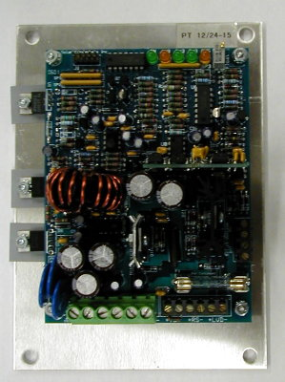
MPPT and DC-DC Choices
AERL (Australian Energy Research Laboratories)
Solar Converters Inc
Outback (and other grid type MPPTs)
Genasun
Nomura Co
Elmar

Slide 19
AERL MPPTs

Slide 20
Electric Motors

Slide 21
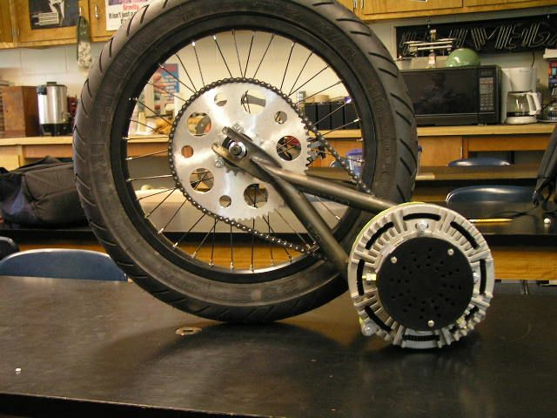
Electric Motors
Brushed Electric Motors
Inexpensive
Lower overall efficiency
Controller is inexpensive and easy to wire
Brushless Electric Motors
Very efficient
More expensive
Controller is more difficult to wire (typically 3 phase)

Slide 22
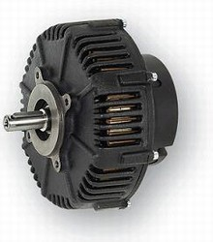
Brushed Motor Examples
Briggs and Stratton ETEK
Lynch LM200
Perm-Motor PMG-132 12-72 VDC
90% efficient
Wide voltage range (12-72 volts)
Light weight (24 pounds)
$1400

Slide 23
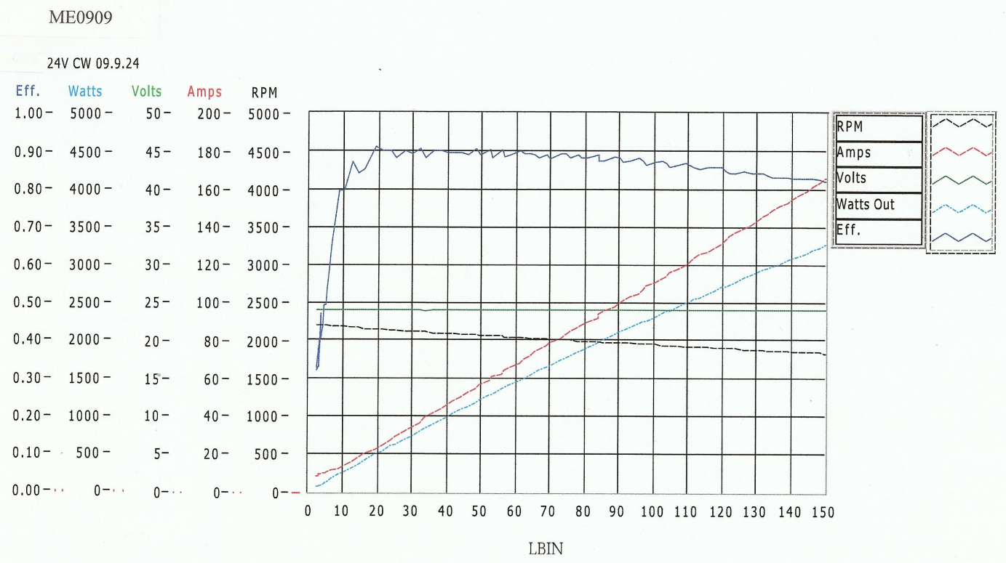
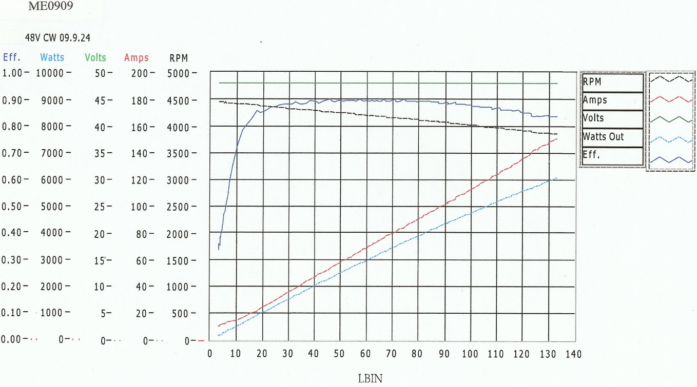
Motor Efficiency Data (ME0909)

Slide 24
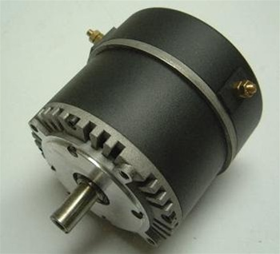
Brushed Motor Examples
Motenergy ME0909 Permanent Magnet DC
Best replacement for original Briggs and Stratton E-tek
12-48 volt
Light weight (24 pounds)
Inexpensive ($450)

Slide 25
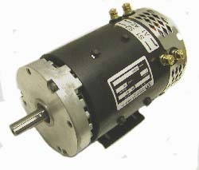
Brushed Motor Examples
Advanced DC K91-4003 motor, 48-96VDC
Higher voltage motor (48-96 volts)
Strong motor for heavier cars
Low cost ($800)

Slide 26
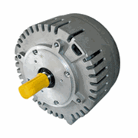
Brushless Motor Example
Motenergy ME0907 Brushless PMSM/BLDC
No brushes=no maintenance
24-72 volts
Very efficient (over 90%)
High current (up to 100 amps continuous)
Motor is inexpensive ($460)
Special controller needed

Slide 27
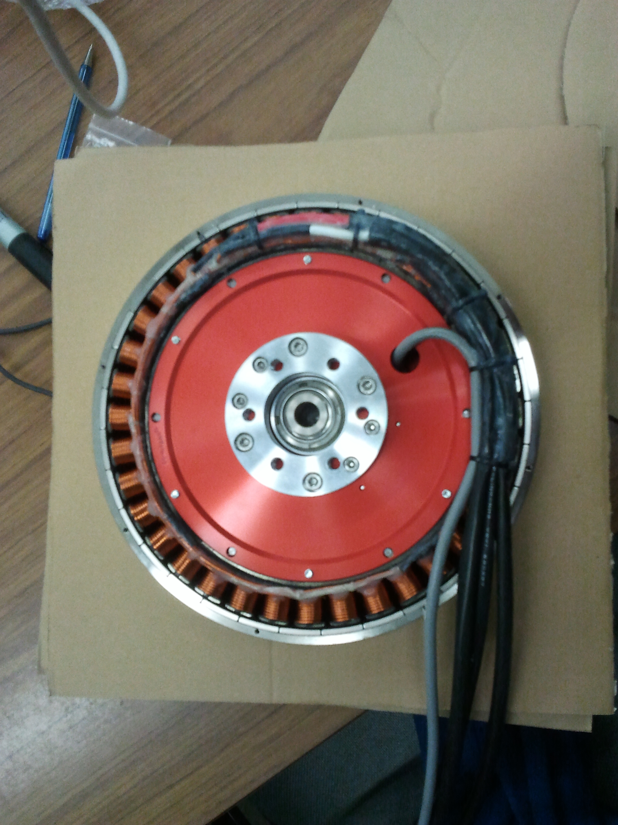
Hub Motor
NGM ‘Direct Drive’ high efficiency in-hub motor with variable air gap adjustment.
Super efficient over a broad range of speeds
No need for gears or chain
Very expensive (Motor + controller > $25,000)
Mitsuba / Nomura hub motors replacing NGM as favored motor for solar car teams
Still ~$25,000

Slide 28
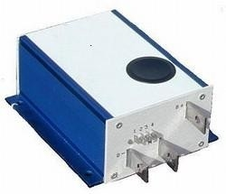
Brushed PWM Controller
Alltrax AXE
Easy to wire
0-5k Pot control
Programmable
Durable

Slide 29
Sevcon controller (Brushless)

Slide 30
A Brief Interlude on Gearing

Slide 31
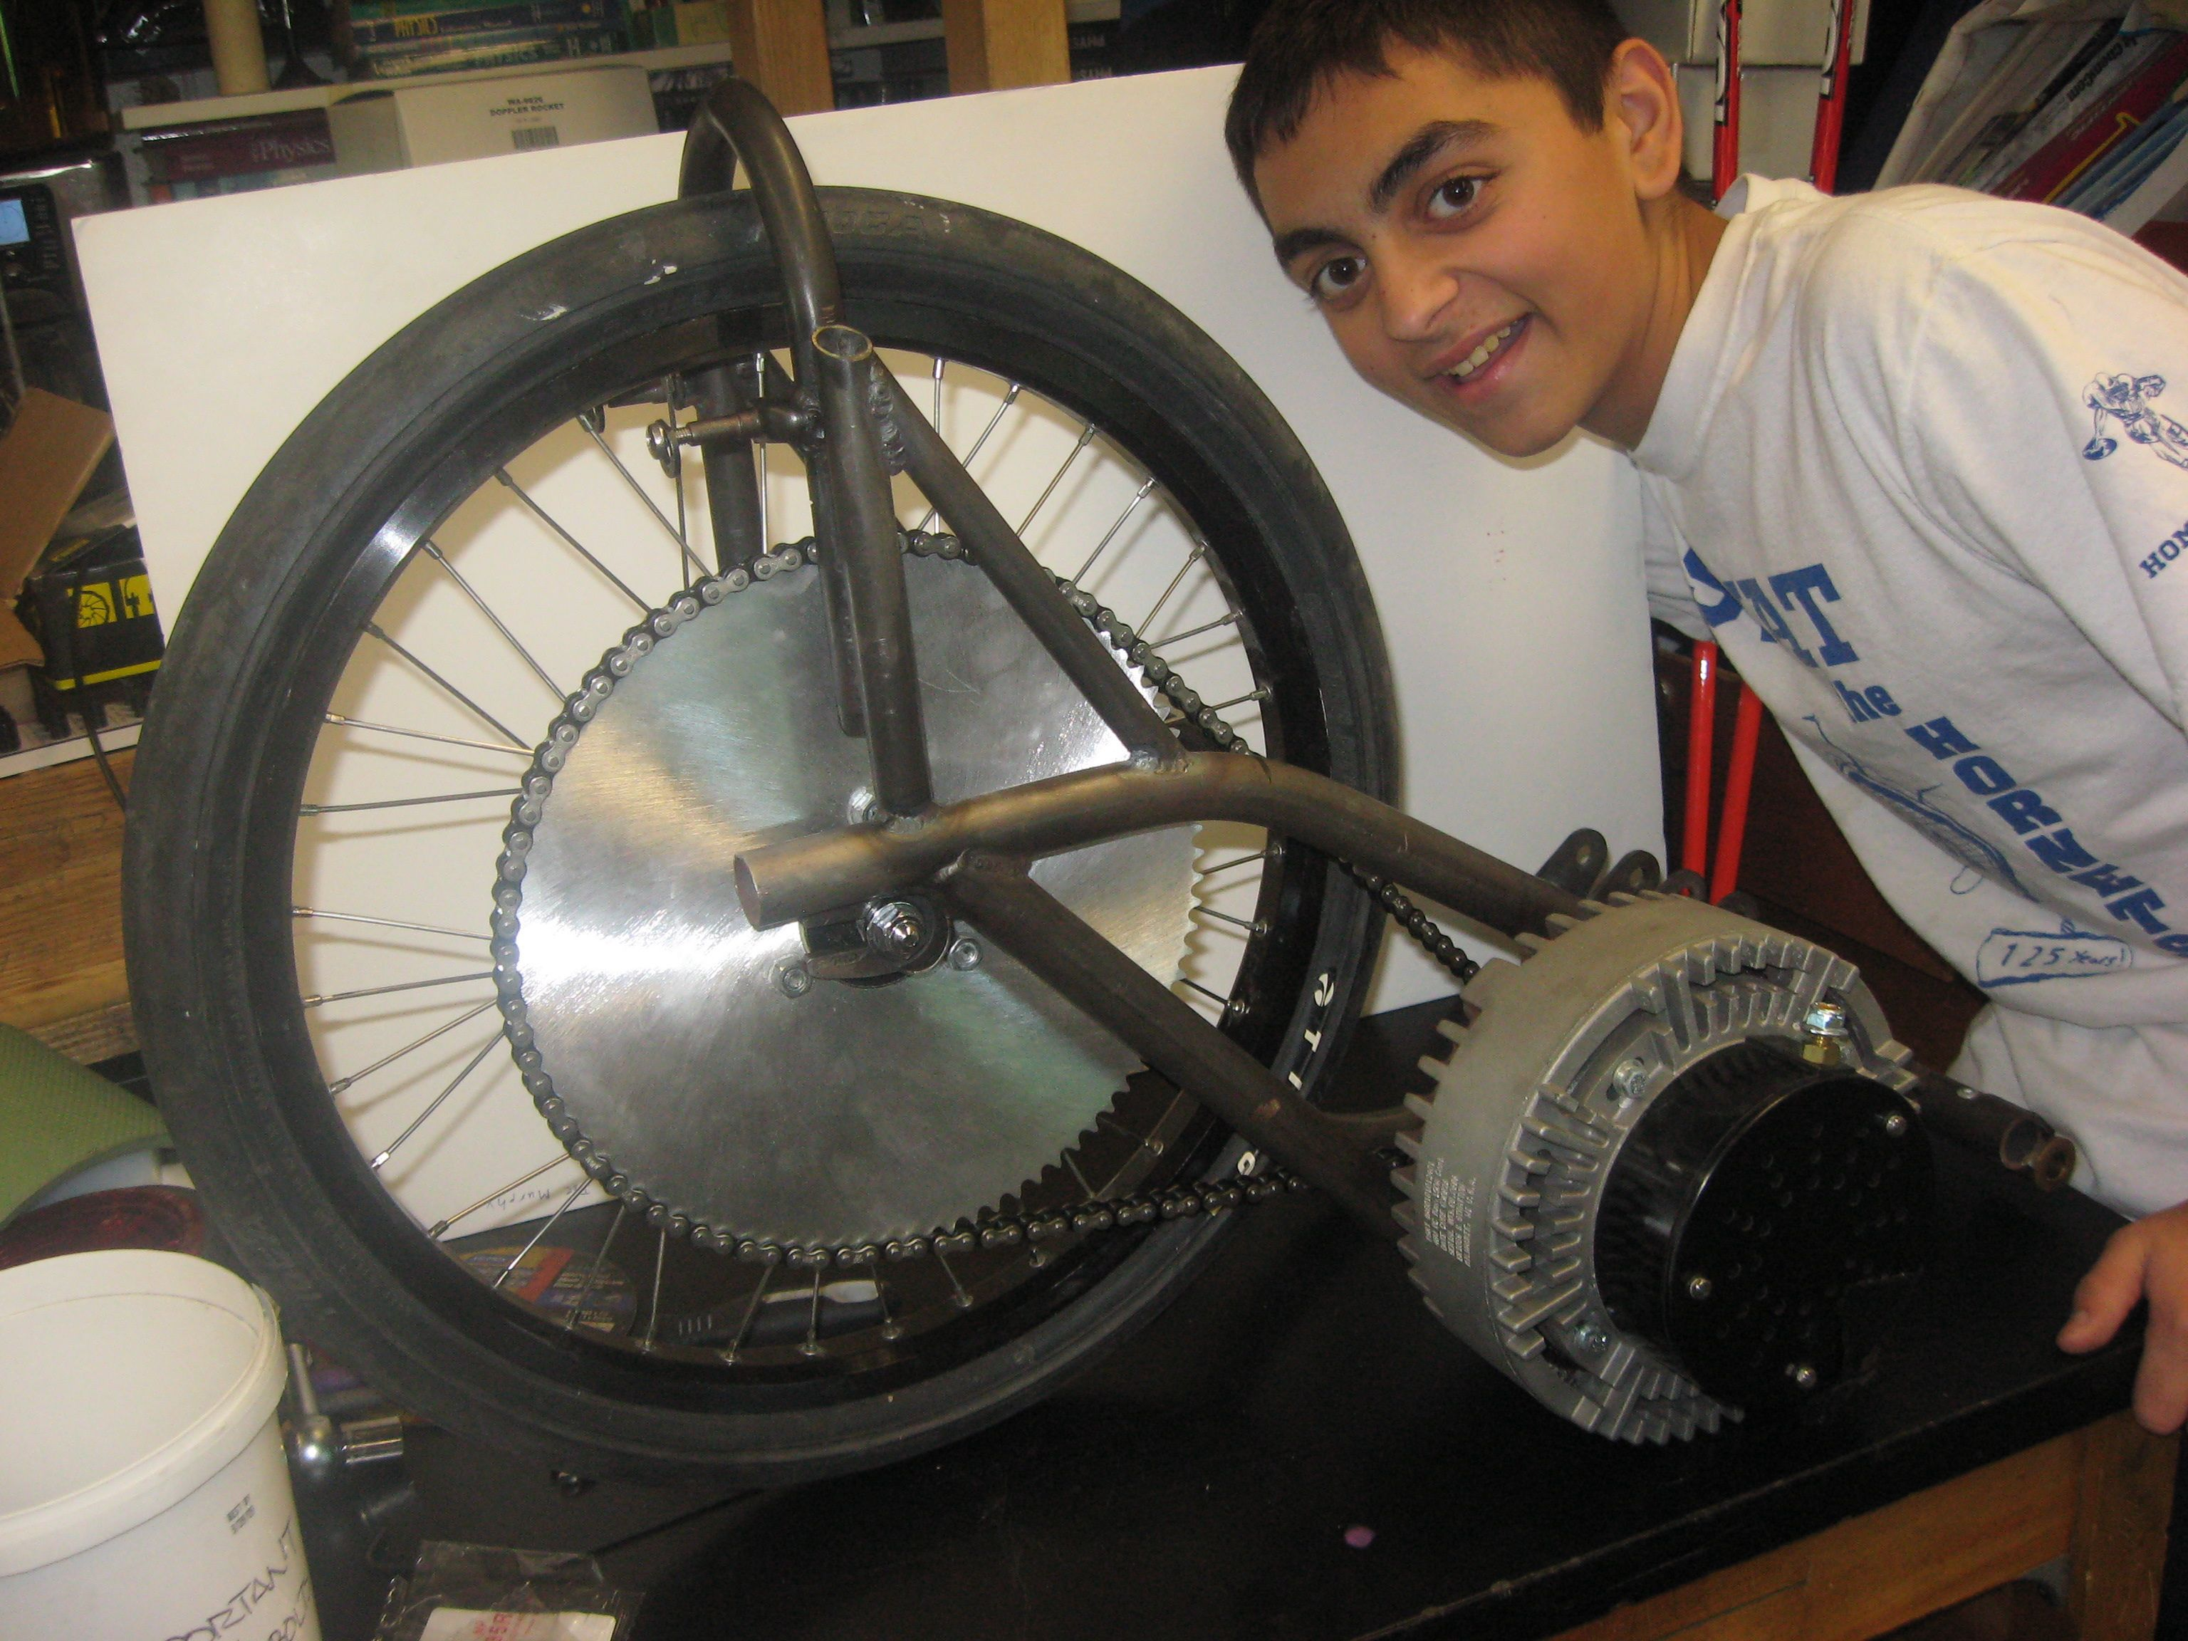
Choose the Correct Gears
Don’t gear a car for 50 mph if you are going to drive it at 25 mph. Be realistic about your cars speed!
Chain drive systems can be very efficient if gears are aligned and lubricated.
Pictured: 48V system, 15 tooth front, 70 tooth rear. Max speed = 36 mph

Slide 32
Gearing to match your motor
How fast will I go with…
$S_{MPH}== \frac{60∗M_{RPM}∗T_{SS}∗π∗D_{Wheel}}{T_{BS}∗5280∗12}$
Variable | Defined As
$$S_{MPH}$$ | Speed in Miles/Hour
$$M_{RPM}$$ | Target Motor RPM
$$T_{SS}$$ | # Teeth Small Sprocket
$$D_{Wheel}$$ | Diameter Wheel in Inches
$$T_{BS}$$ | # Teeth Big Sprocket

Slide 33
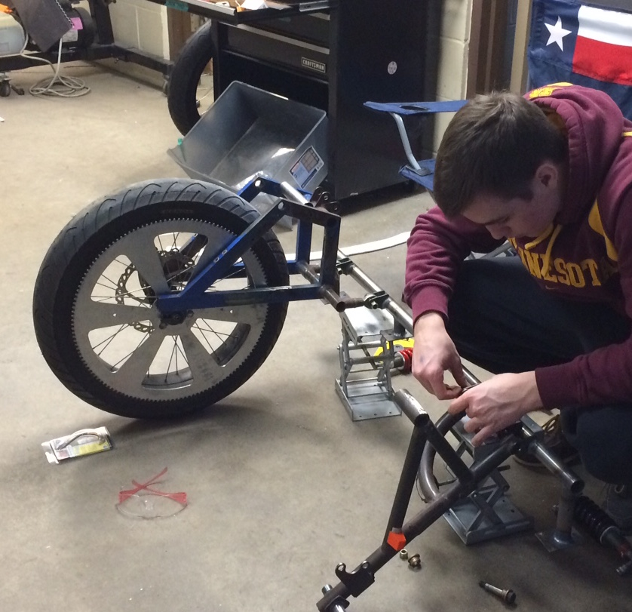
Choose the Correct Gears
Custom Sprockets:
Rocket Sprockets www.rocketsprocket.net
PMP Sprockets www.pmpsprocket.com

Slide 34
The Electrical System

Slide 35
Electrical System

Slide 36
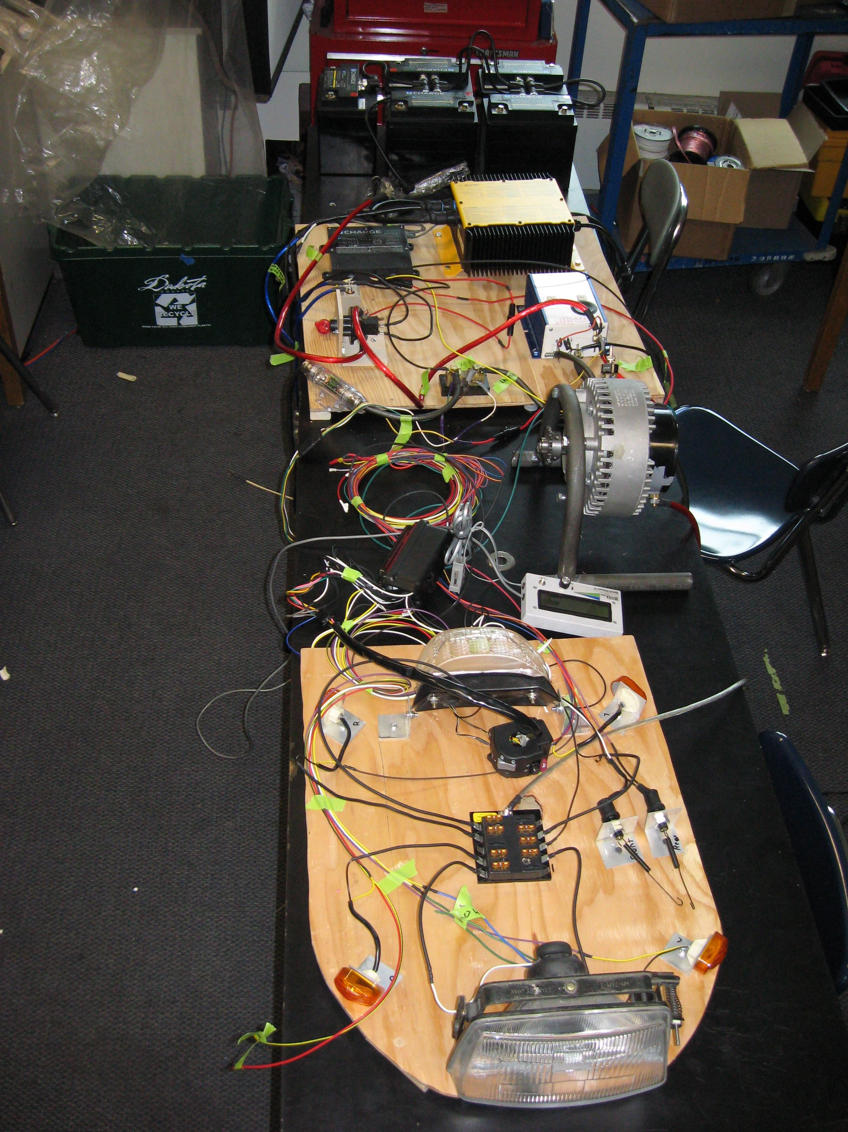
Electrical System
Propulsion System
Use the correct gauge wire for the job
Disconnect switches should be designed for DC
Fuses
Auxiliary electrical system (everything else on your car)
Lights
Fans
Horn

Slide 37
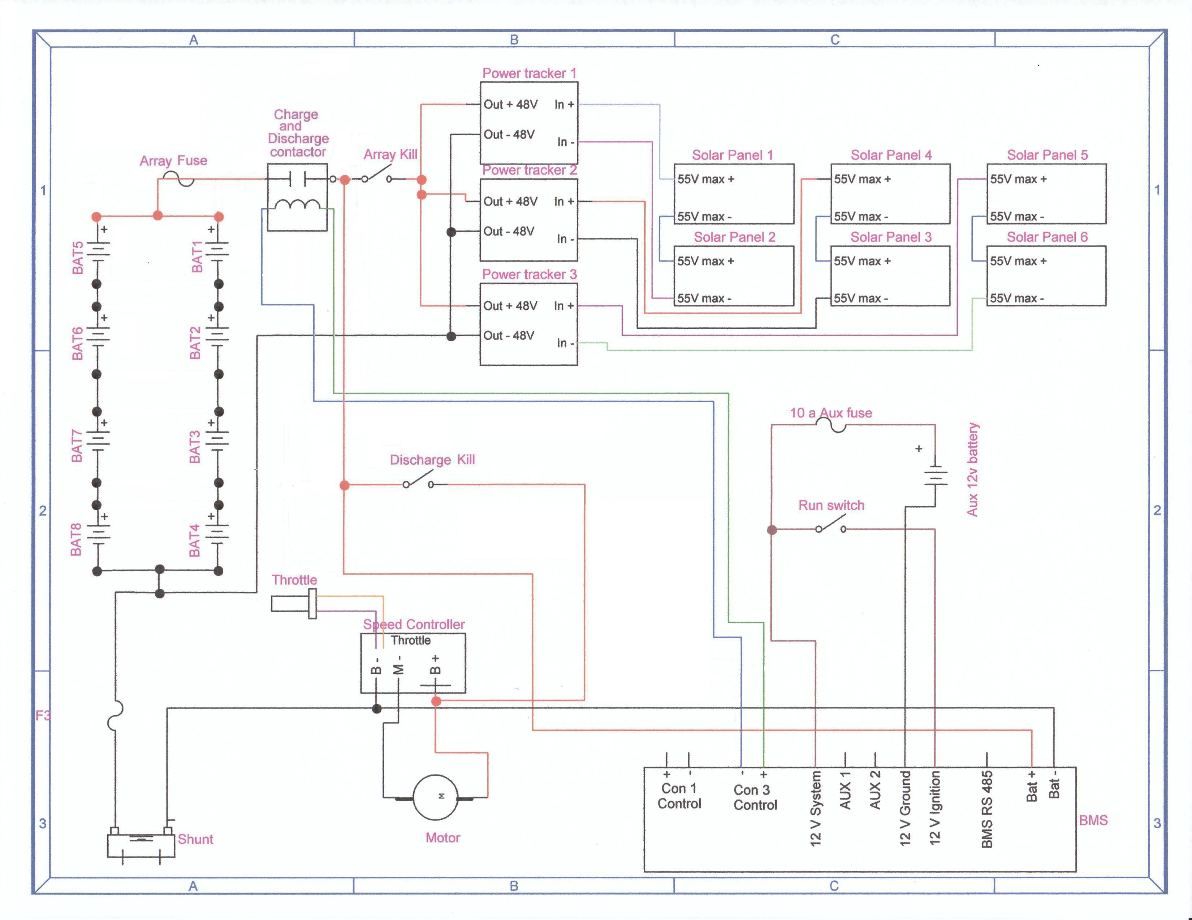
Electrical Schematics

Slide 38
Batteries

Slide 39
Batteries
Choose carefully!
Batteries are one of the areas where you get what you pay for.
Decisions to make:
What voltage does your car run at?
Higher voltage means lower current .
How much weight can you carry?
How much energy can you get at that weight?
Can your solar panels recharge the battery pack?
Is it a road race or a track race?

Slide 40
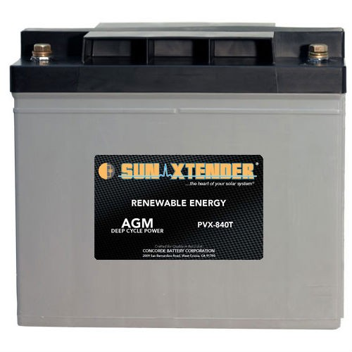
Batteries
The 5 kilowatt-hour rule
kw-h = Amp-hours x Voltage
(at the 20 hour discharge rate)
Example:
Four, 12 volt, 84 amp-hour batteries in series
84ah x 48 v = 4032 watt-hours or 4.032 kilowatt-hours
(this battery pack would weigh around 230 pounds)

Slide 41
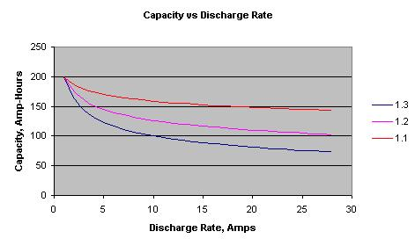
Batteries
Choosing batteries based on the Peukert number:
A typical sealed lead acid battery has a Peukert number between 1.1 and 1.3. (The closer to 1.0 the better!)

Slide 42
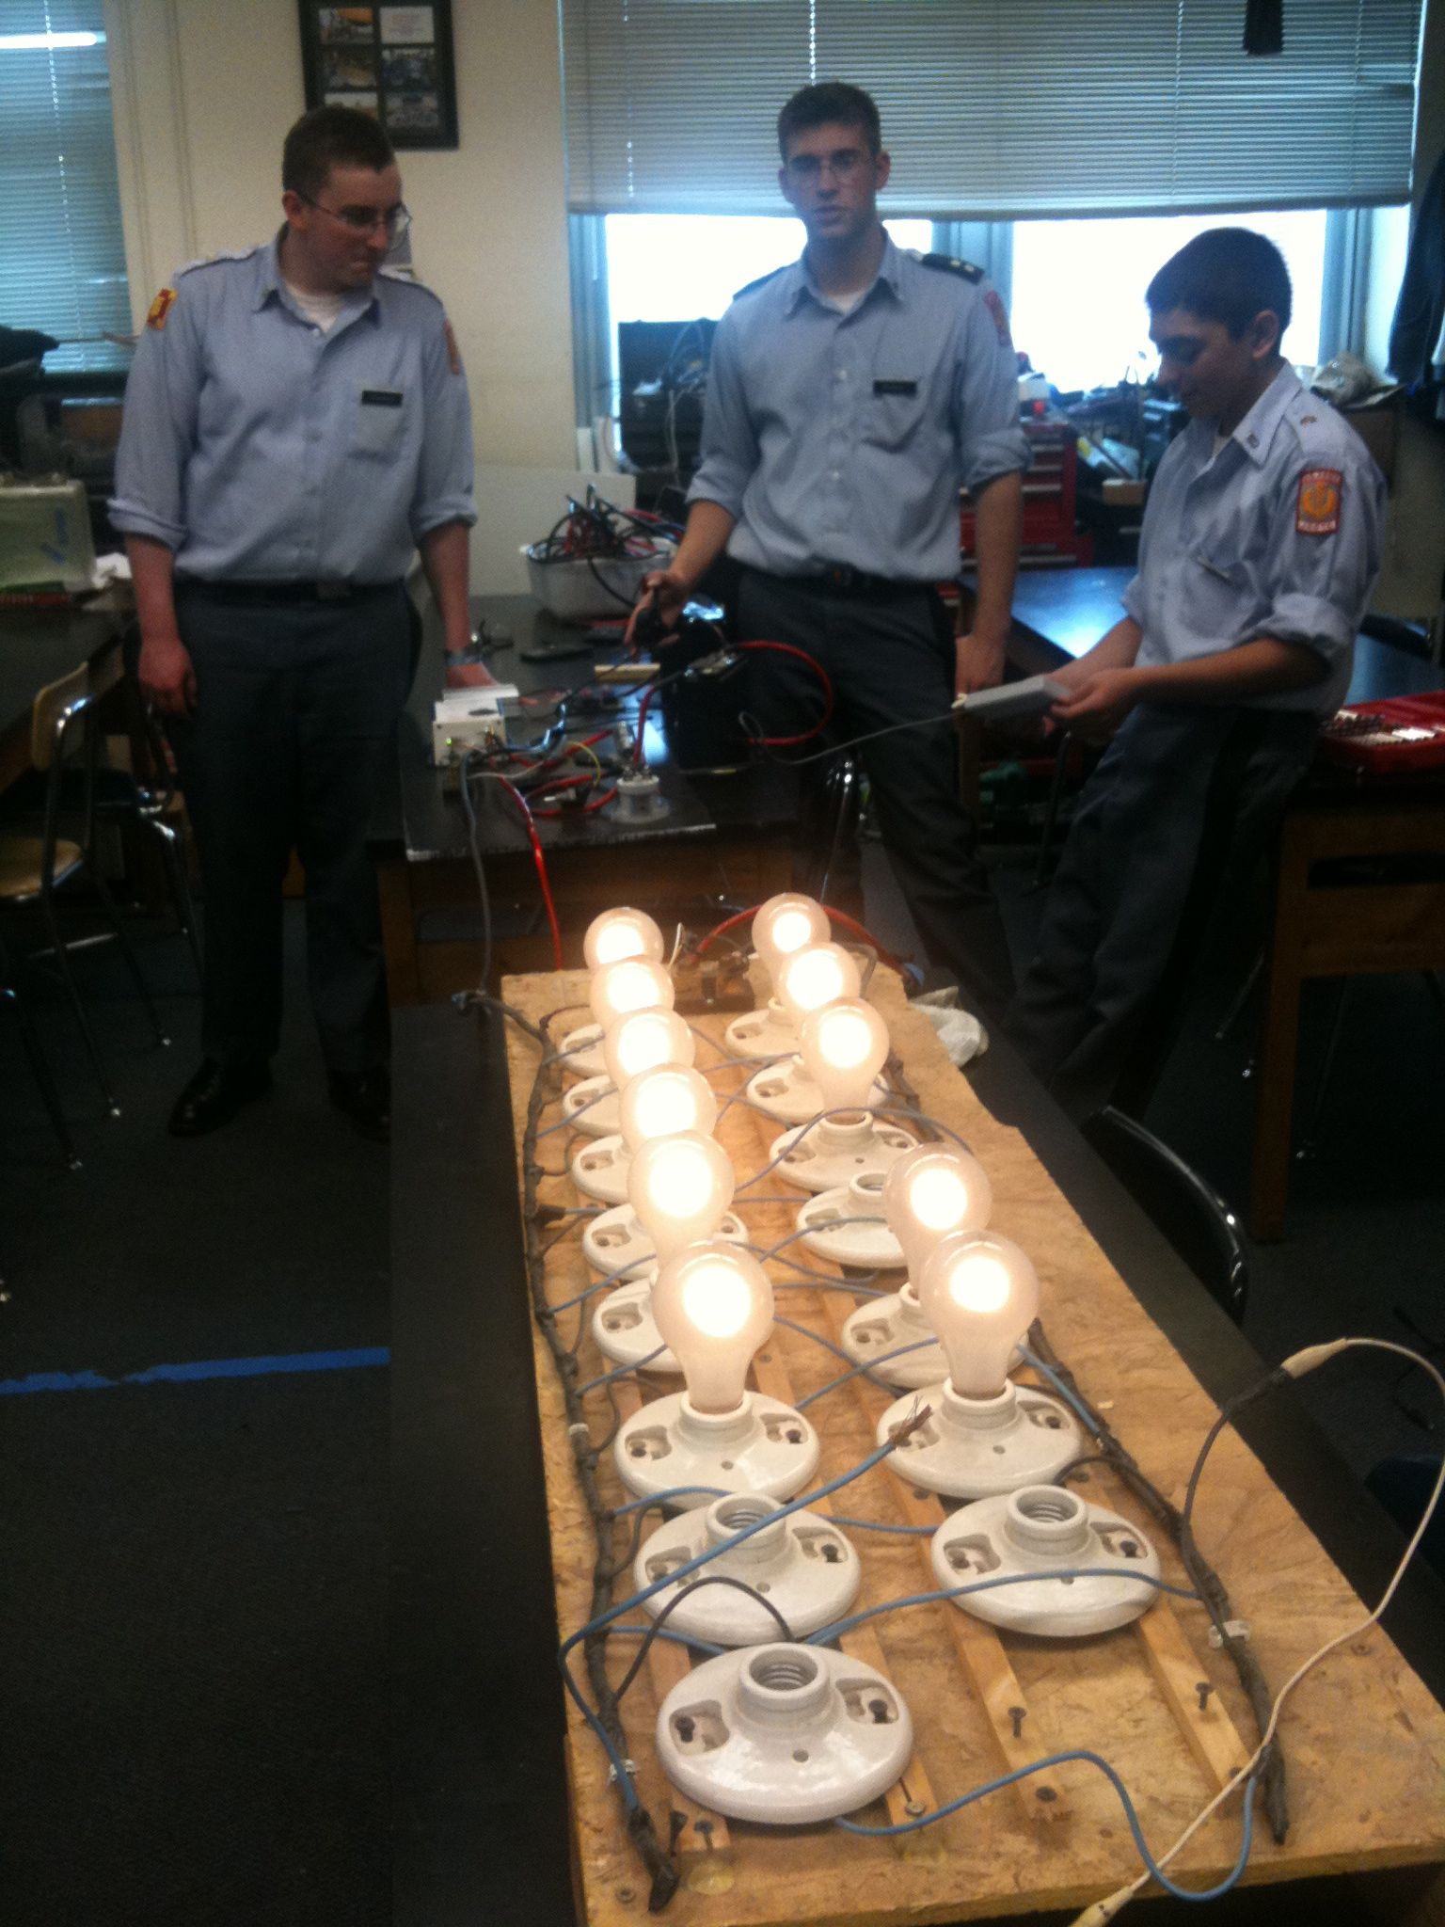
Batteries
Testing batteries:
Understanding how your batteries perform is one of the most important things you can know BEFORE the race starts.
Carefully recording voltage, current, and amp-hours will help your team make good decisions during the race

Slide 43
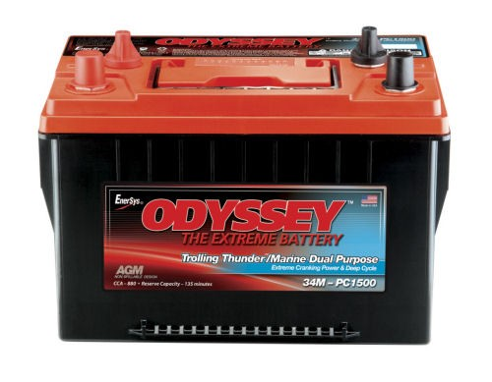
Batteries
Some of our favorites:
Concorde Sun Xtender series
84 Ah $245/battery
EnerSys Odyssey Marine series
68 Ah $250/battery

Slide 44
Everything Else Electrical

Slide 45
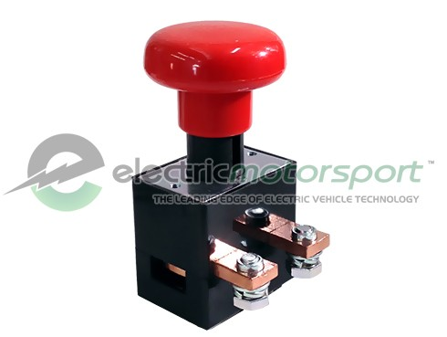
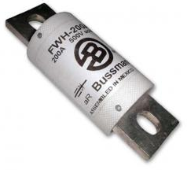
Switches/Fuses
There are a lot of resources for switches and fuses. Be sure they meet the race requirements before ordering!
Be sure they are rated for your DC system. (AC rating will not qualify!)
(Bussmann FWH Fuses are rated at 500V DC)
Relays are required!
Electric Motorsport www.electricmotorsport.com
Tecknowledgey
http://www.tecknowledgey.com
Single Pole On/Off Rated load: 400 A Break Current: 1200 A @ 48 V DC (600 A @ 96 V DC)
500V DC @90 amp fuse is about $50

Slide 46
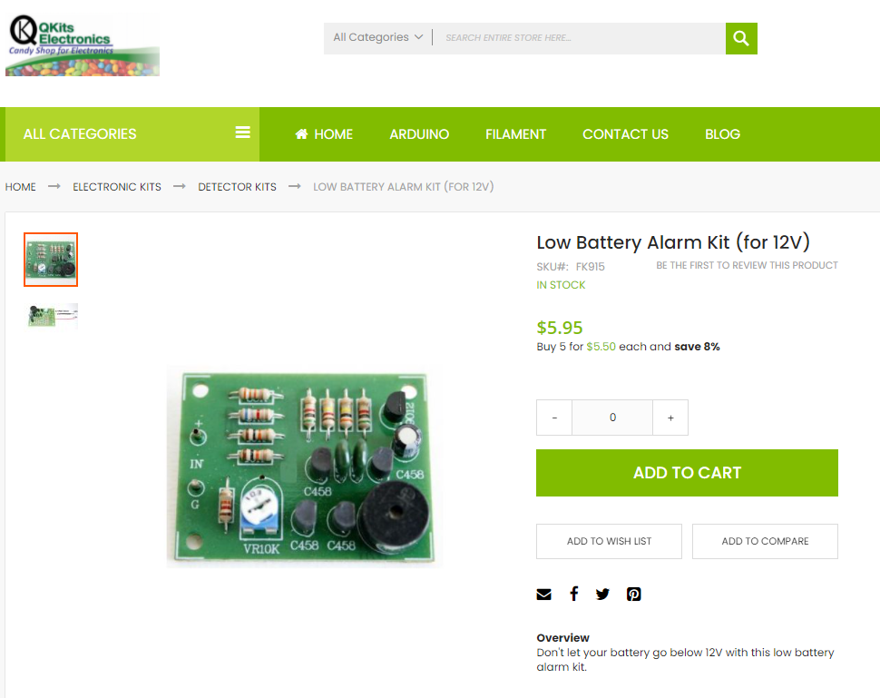
Low Voltage Indicator
Cots Solution
Do-It-Yourself kit available at:
http://store.qkits.com/
Look for “Low Voltage Alarm”

Slide 47
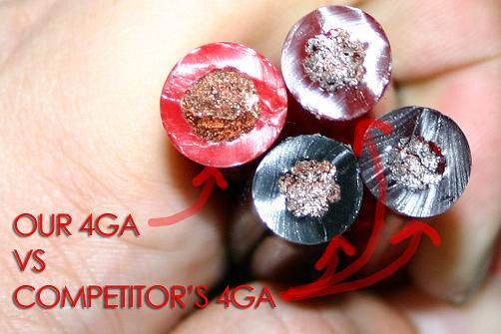
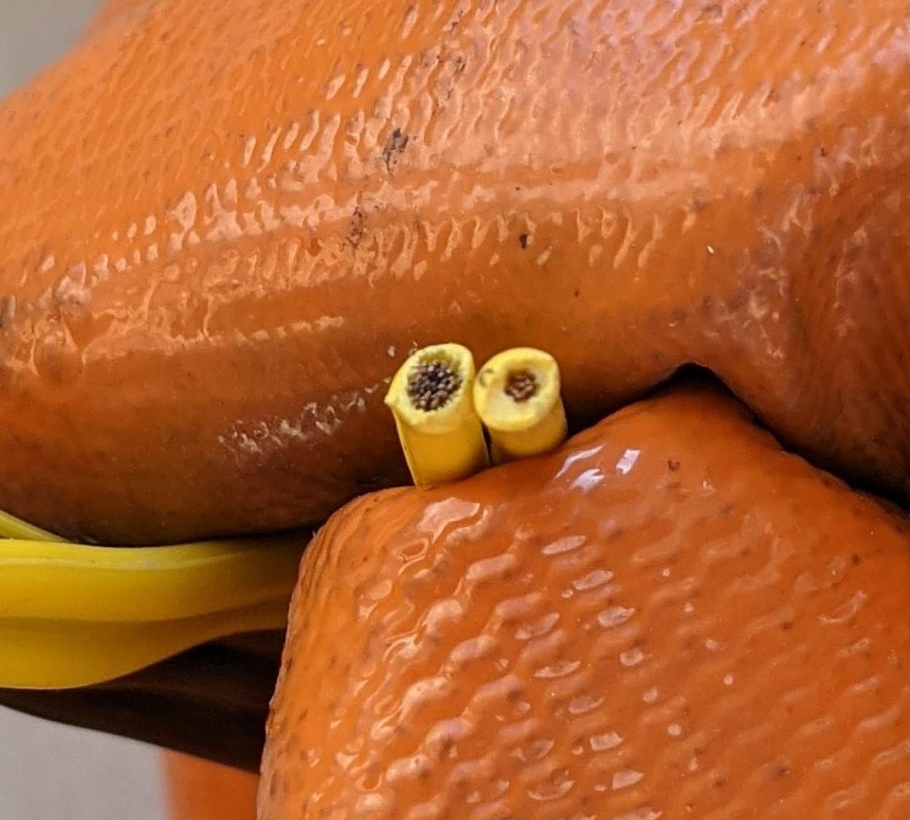
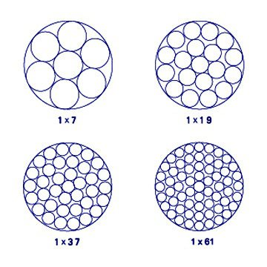
Wire
Propulsion System Wire
Use welding cable
Should be very flexibly
Use proper crimping tools and lugs
Don’t attempt to solder
Don’t attempt to splice
Be aware of counterfeit cables
Be sure to size to your system
Auxiliary System Wire
Have a variety
Get higher quality wire with more strands
http://www.flex-innovations.com/counterfeit.htm
Different Strand Configurations
For the same wire gauge

Slide 48
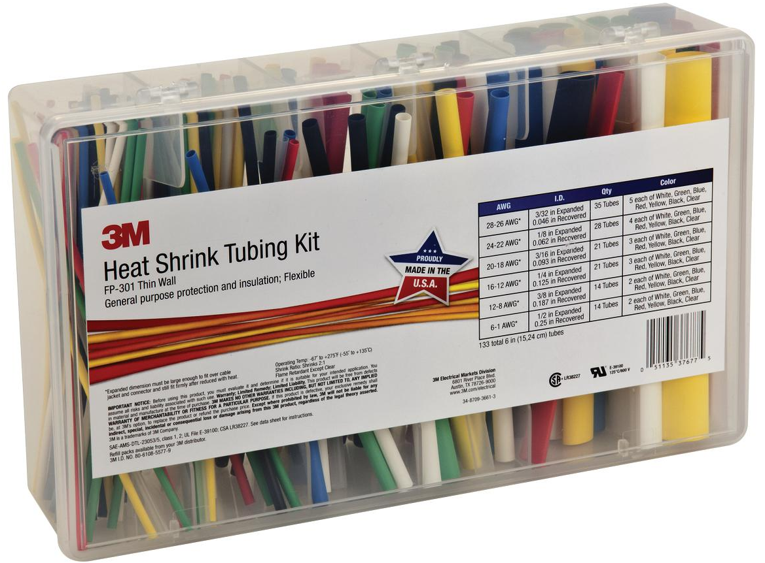
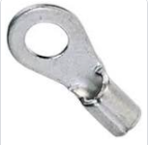
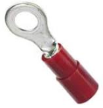
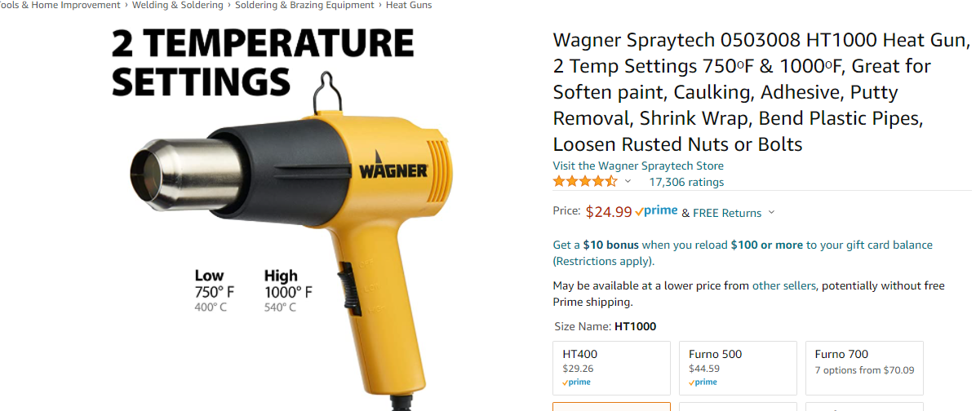
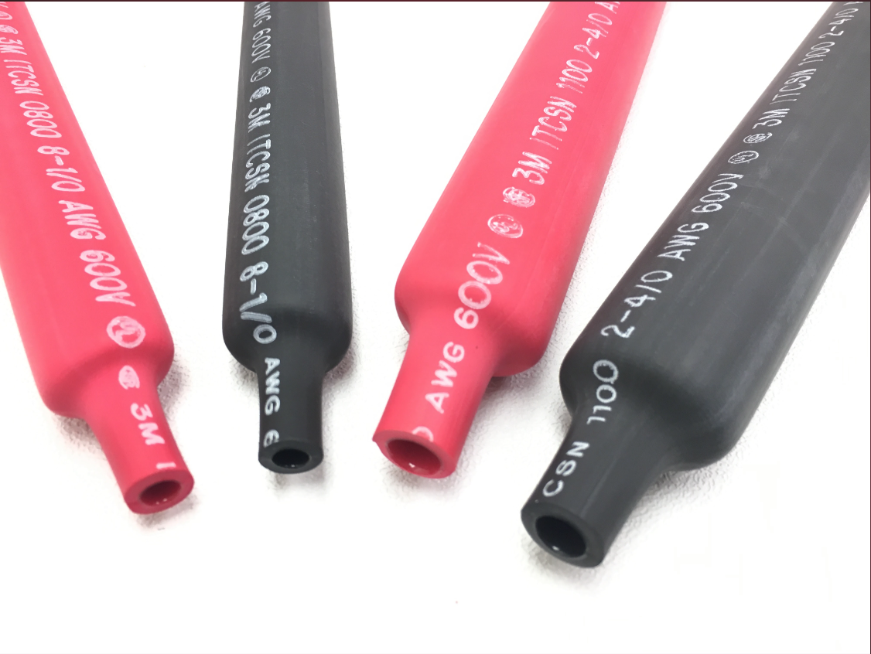
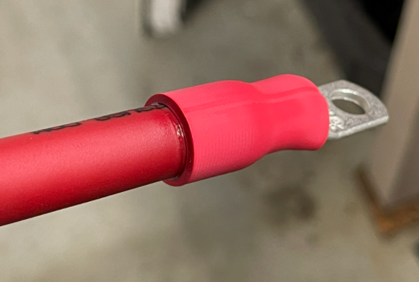
Heat Shrink
Heat shrink
Should always be used
It’s worth it to spring for the 3M heat shrink
You will need a heat gun
X
✓

Slide 49
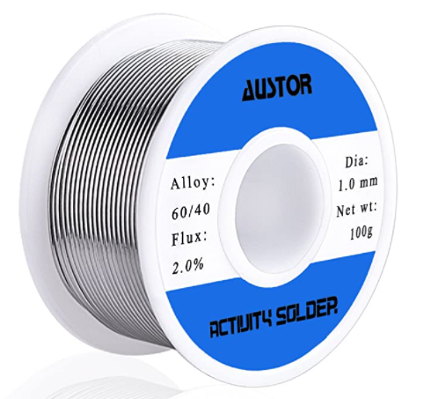
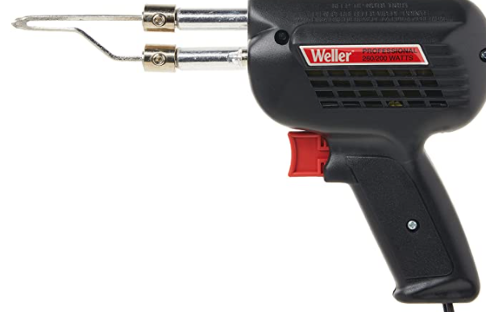
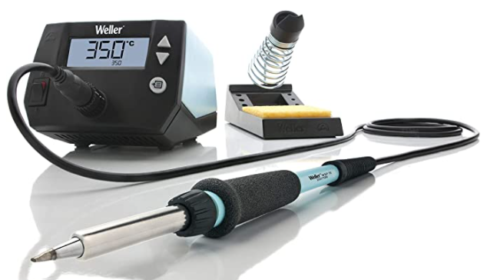
Soldering
Tools Needed
Wire strippers
My preference is nothing fancy
Solder
Lead free can be used but 60/40 Tin Lead Rosin Core is typical
There are many diameters
Very small diameter (0.6mm) solder is not meant for 16 ga / 18 ga wire
Larger diameter (1.5mm+) solder is not appropriate for fine soldering (like making connections on a printed circuit board)
Irons vs Guns
Irons
Slow to heat up / slow to cool
Precision temperature control and application with different tips
Recommended for fine work (PCBs, solar Cells, ect.)
Gun
Fast to heat up / Fast to cool down
One or two temperature settings
Good for working on general solar car wiring
Most reliable wiring
Crimp connectors that have been crimped and soldered with a heat shrink sleeve
Tin wires before putting them in the heat shrink

Slide 50
Any Questions?

