Slide 1
Rules for the 2022 Race
William Shih, Deputy Race Director

Slide 2
EVENT UPDATES
The Rules are periodically clarified or amended to meet the needs of the specific race.
Rule 29 requires solar car teams to make periodic reviews of these updates to stay up-to-date.

Slide 3
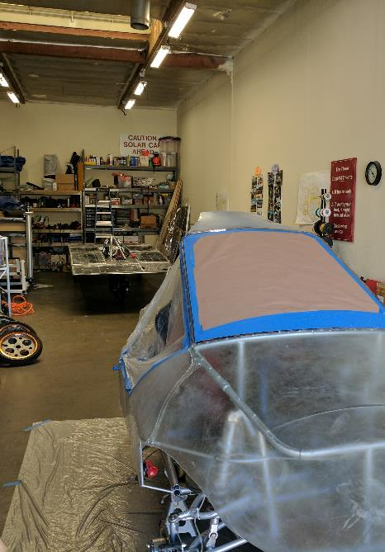
Rules Overview
Do:
  Keep copies of rules throughout workshop
  Following engineering lifecycle: requirements, design, implementation, verification
Don’t:
  Just read once or all in one sitting
  Look at another car’s design and assume it complies with rules (grandfather; waivers)
Changes from 2021 rules noted in Blue

Slide 4
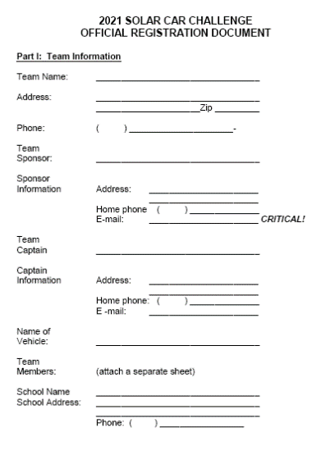
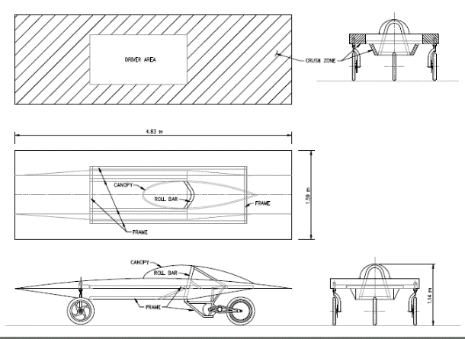
Registration
Sections 1 – 3: Purpose, Administration, Entries and Registrations
Registration Documents and Registration Fee requirement March 1st:
(1) Detailed CAD drawings showing mechanical structure, including “crush zones.” Crush zones must be clearly labeled.
(2) Detailed schematic / wiring diagram showing electrical system.
(3) Digital team photo [emailed]
(4) Manufacturer’s data sheets for batteries showing type & capacity
(5) Manufacturer’s data sheets for solar array, including list price
(6) Manufacturer’s data sheets for motor and motor controller
(7) Manufacturer’s data sheets for array and battery cutoff switches
(8) Manufacturer’s data sheets for main fuses
(9) Manufacturer’s data sheets for wheels and brakes
Digital and hard copies required by March 1st.

Slide 5
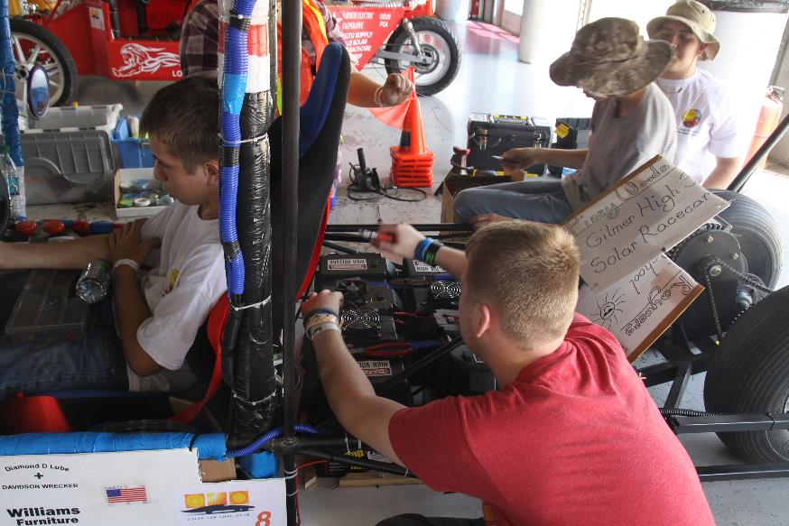
Rule 3.8 – Design of Solar Car
It is the intent of the event that the solar cars be designed and constructed by high school students on the solar car team.
No portion of another vehicle’s frame may be reused in a solar car unless the team re-engineers/ modifies the frame to fit the team’s solar car design or to install separate off-the-shelf components.

Slide 6
Rule 3.9 - Scrapbook
Scrapbook must be shown to Check-In to Race.
Scrapbook must show history of the team building the solar car, including team engineering decision-making.
Scrapbook will show team photos, design & planning, CAD drawings, fundraising, testing.
Digital copy of scrapbook due June 1st.

Slide 7
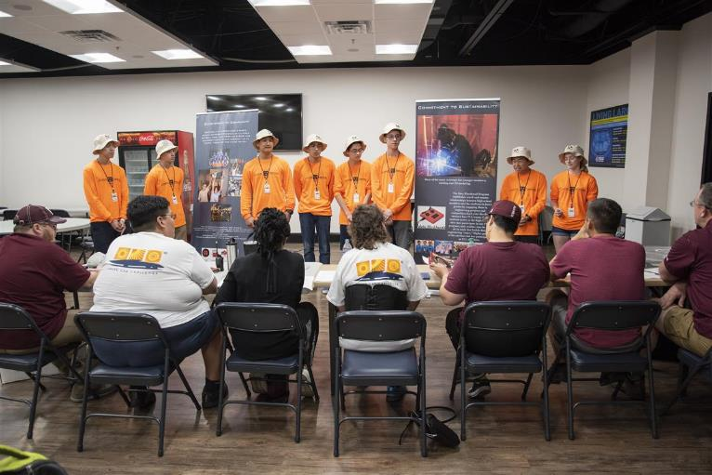
Rule 3.10 – Oral Presentations
Up to 20 laps not available for oral presentations.
Presentation show discuss the teams overall planning, including engineering decisions.
Teams have a strict 8 minutes to give their presentation.
Judges will now give feedback per Oral Presentation Guidelines

Slide 8
Rule 3.5 – Qualifier
Qualifier for the 2021 Race will include:
  3-Day Scrutineering
  Stage One – First Day of Racing
The top teams in each Solar Car Challenge Racing Division will move on to the three-day Stage Two of racing. [Approximately 25 teams]
  The winner in each division will be the team that accumulates the most laps in Stage 1 and 2.
  All teams will receive an Official Race Ranking

Slide 9
Section 10: DIVISIONS
Classic Division: No hub motors; lead-acid batteries; solar modules or cells at ≤ 20% efficient
Advanced Classic Division: 3 or more years in classic with same basic vehicle structure and major components
Advanced Division: Hub motors; prefabricated solar car molds; advanced battery chemistries
Electric-Solar Powered Car Division: Solar cells on charging station; Classic Division technology; 2 x 2kWh battery packs
Cruiser Division: Seating for four; totally enclosed; solar array integrated into the skin of the vehicle; workable trunk

Slide 10
Minor Updates
Rule 5.1.2 (Stability): No rear-wheel steering
Rule 5.18 (Fasteners): Nylon locking nuts require two threads showing
Rule 5.21 (Waivers): Waivers not limited to roll cage, roll bar, crush zone; will require submission of engineering analysis for equivalency to waived rule

Slide 11
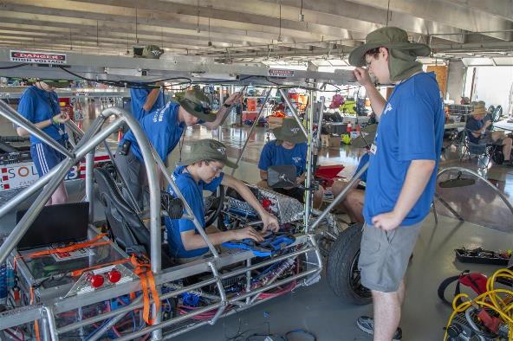
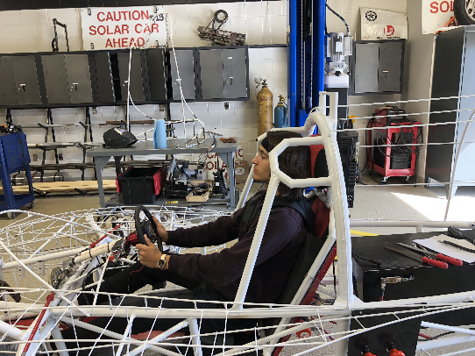
Rule 5.2.x –
Roll Cage, Crush Zone, Roll Bar
Roll Cage – rigid protection encompassing entire driver; minimum OD of 1.9cm; minimum 5cm clearance to driver
Crush Zone – structural components designed to collapse on impact; minimum 15cm clearance to driver; minimum coverage
Roll Bar – protects driver in event of rollover; continuous piece of metal; minimum 5cm vertical clearance; minimum OD of 5cm; minimum wall thickness based on material; welded to frame

Slide 12
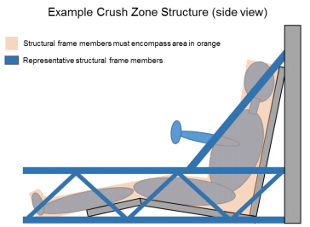
Roll Cage / Crush Zone Details
Both Roll Cage and Crush Zone must encompass the entire driver
Crush zone are structural components designed to collapse on impact
Roll cage structure protects driver in event of collision; should not deform

Slide 13
Section 5.4/5.7 – Electrical
Rule 5.4 (Battery): 5 kWh max at 20 hr discharge rate; terminals must have locking washers (see 5.7.3 below).
  For Lithium-based chemistries, use nominal (1C) capacity
Rule 5.4.2 (Main Fuse): 125% of expected peak current, separate enclosure; rated as appropriate for DC voltage
Rule 5.4.3 (Enclosures): Rigid, must have forced-air ventilation; no venting into driver’s compartment; cannot be located at front of vehicle
Rule 5.7.1 (Wire): No HV wiring in driver’s compartment
Rule 5.7.3 (Connections): Connections conducting > 36V must be secured by locking washer

Slide 14
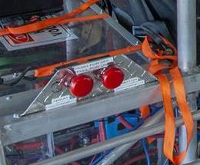
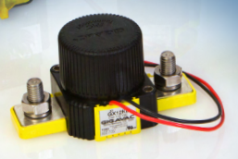
Rule 5.4.5 – Disconnect Switches
Two sets of two switches required
  Motor Disconnect / Array Disconnect
  Internal (“Driver”), External
Relay/contactor must interrupt full load current at system voltage
Switch operates control signal of relay/contactor

Slide 15
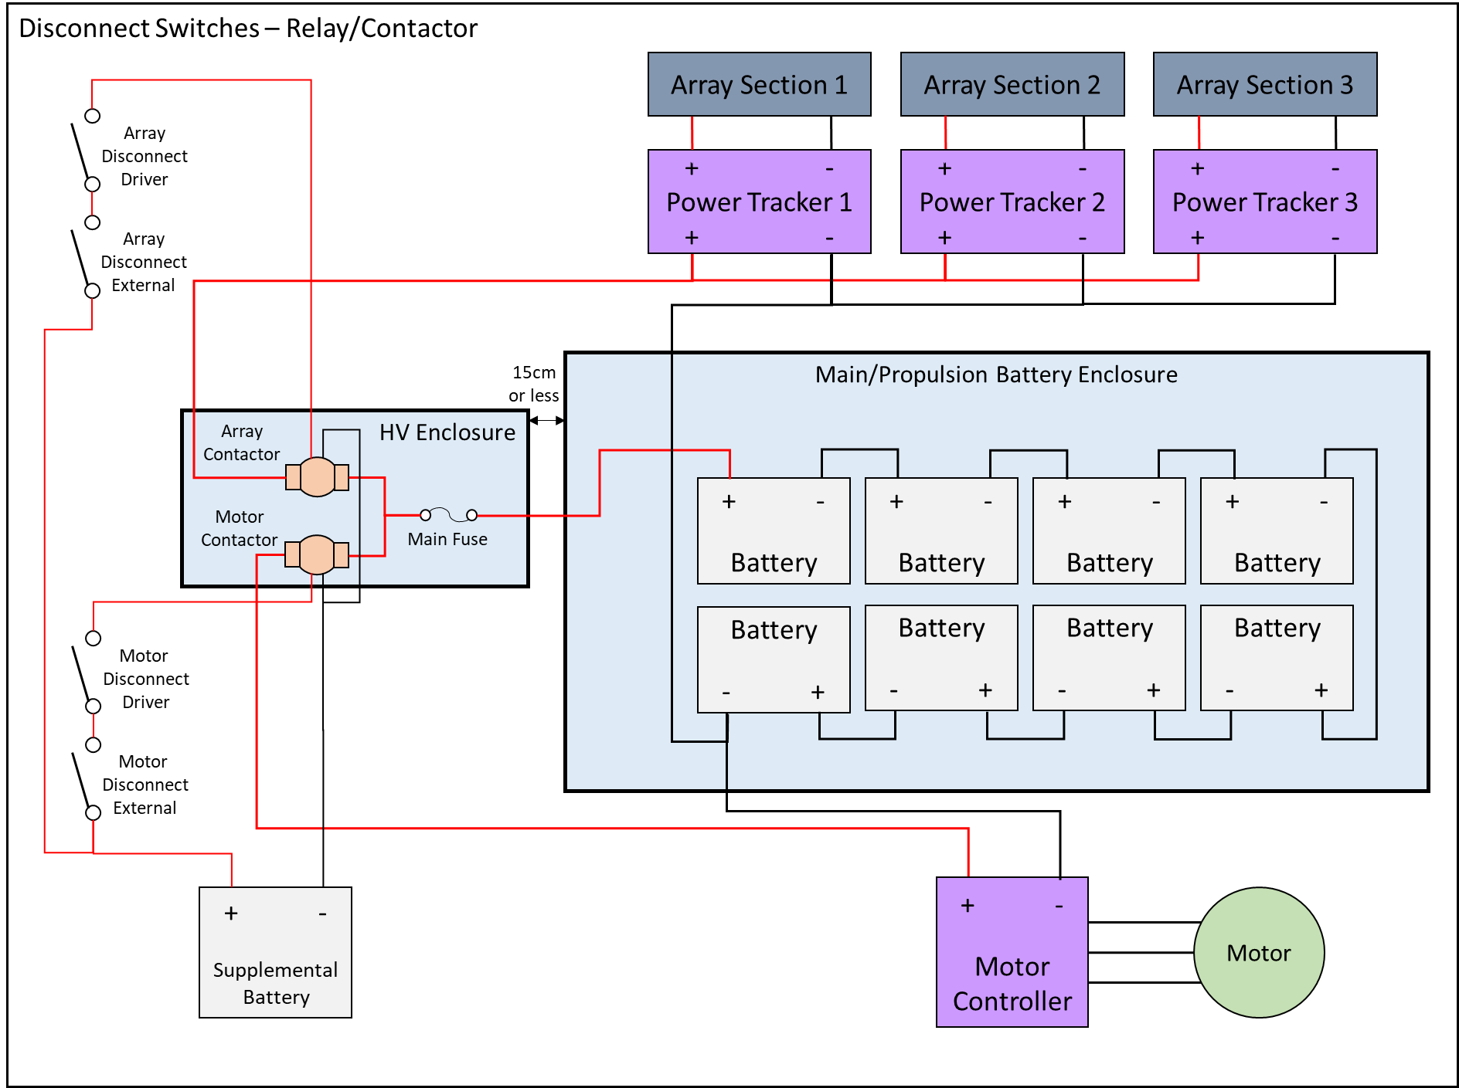
Relay/Contactor Circuit
Control Switches
Relay/ contactor

Slide 16
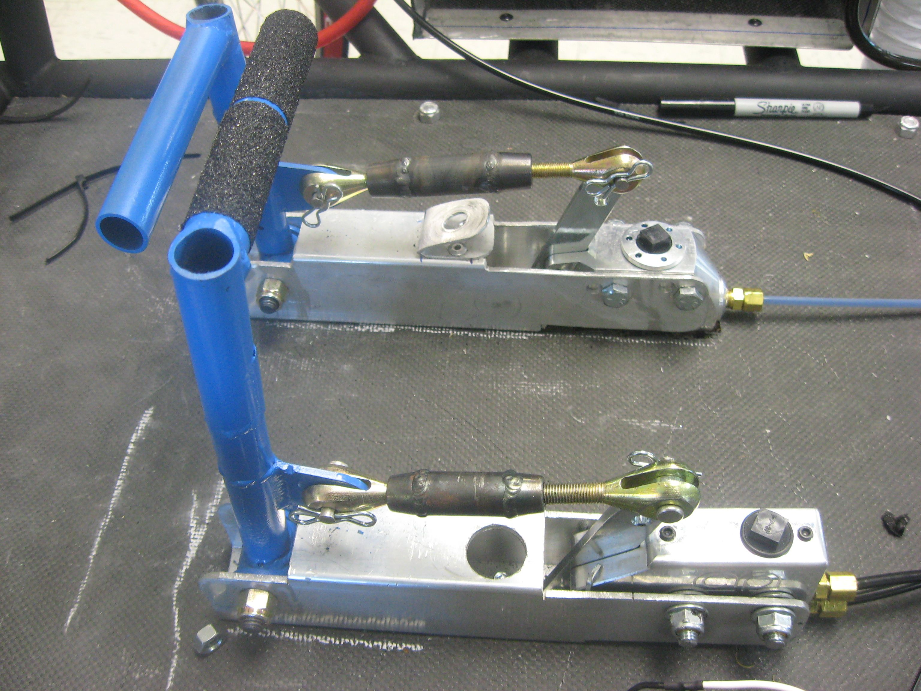
Section 5.10 – Braking
Rule 5.10 (Braking): Can no longer “link” pedals together
  Each part of the braking system, from actuator (pedal) to master cylinder to brake calipers must be independent
X

Slide 17
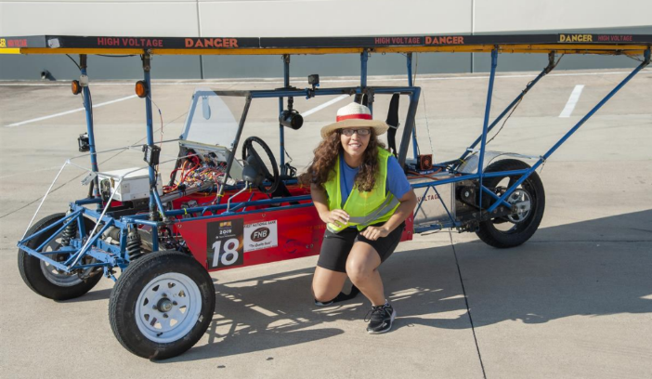
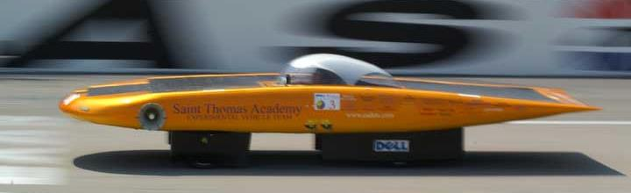
Section 5.12 – Lights/Horn
Rule 5.12.1 - Lighting
  Stop (“Brake”) Lights must be red; visible at 100 meters
  Front/Rear Turn indicators must be amber; visible at 30 meters
  Therefore, car must have 6 total lights – two red stop lights and four amber turn indicators
Rule 5.12.2 – Audible Warning
  Mount as far to the front as possible; face forwards
  Required to be used when overtaking another solar car; make sure it’s loud enough and there’s enough batteries!

Slide 18
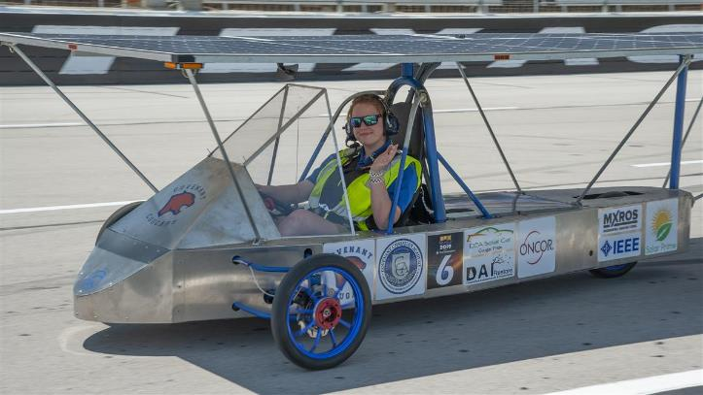
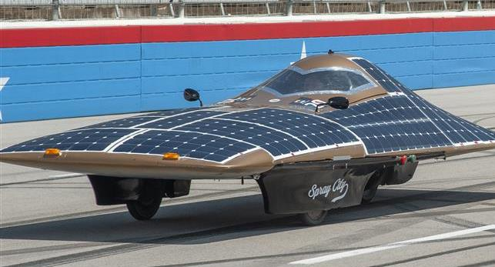
Rule 5.13 – Driver Safety
(a) Safety Belt must be 5 point lap/shoulder harness; attached to structural member per manufacturer’s instructions.
  Requires mounting shoulder belts vertically lower than driver’s shoulder
(b) Cars with body shells must have shells attached to each other
(d) Windshield must protect entire head
(e) Cars equipped with appropriate fire extinguisher for battery chemistry

Slide 19
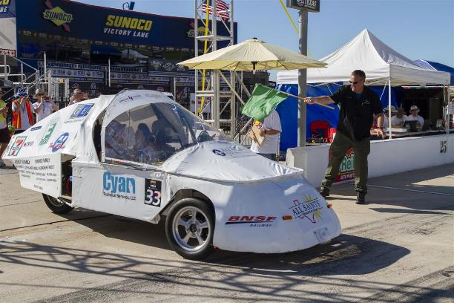
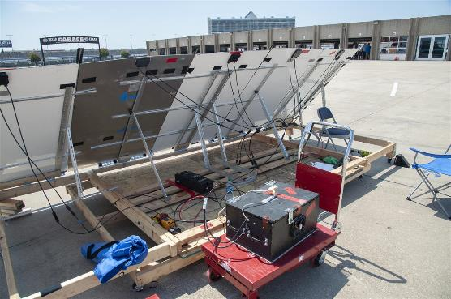
Section 32 – Electric-Solar Powered Car
Simulates a “real world” solar application
  Two passenger vehicle
  Charging Station simulates permanent facility used to charge vehicle
Same rules as Classic Division, with exceptions
Rule 32.2.3a (Configuration): Passengers must be seated side-by-side
Rule 32.2.6 (Battery): Two battery boxes, each with maximum 2kWh capacity; safe battery exchange procedure
Rule 32.2.7 (Disconnects): Solar Car must have two Motor Disconnects; Charging Station must have single Array Disconnect
Must provide team member to monitor Charging Station during race hours
  For road race, charging station is mounted on support trailer
Rule 32.7 (Team Assignments): Accomplish one special task each day to demonstrate real-world function

Slide 20
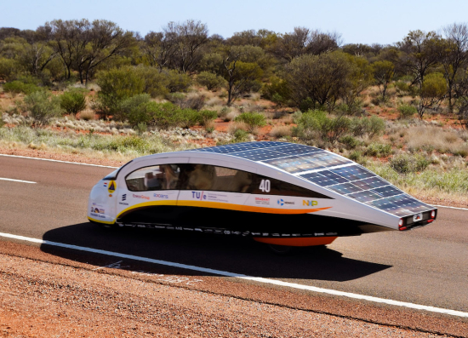
Section 33 – Cruiser Division
Resemble regular passenger vehicle; provides opportunity to strategize based on number of passengers
  Points = # of passengers x distance traveled
Same rules as Advanced Division, with exceptions
Must have four wheels
Must accommodate four passengers; each with immediate access to door for entry/exit (implies 2x2 configuration)
Rule 33.3.5 – Body must be completely enclosed
Rule 33.3.6 – Solar array must be integrated into car body
Rule 33.3.7 – Must have externally accessible storage space

Slide 21
Attire
Attire for all participants (including students, sponsors, chaperones, advisors, and others participating or traveling with team) in the Solar Car Challenge must be appropriate.
All participants must wear full-brimmed hats when in direct sunlight and closed-toe shoes throughout the event. Jeans are recommended for protection when working on the car and when kneeling on the ground. Shorts must be longer than the longest fingertip.

Slide 22
Attire During the Solar Car Challenge
The Solar Car Challenge is based on the philosophy of “cooperation rather than competition.” Our event focuses on bringing teams together through the camaraderie of the solar car experience.
In keeping with this philosophy, we ask that team attire, banners, and printed materials focus on their solar car team logo, “school pride,” or community.
No attire, banners, or printed materials will be allowed that seek to promote any political candidate or philosophy. Failure to follow this guideline will result in the removal of the offending items and/or disqualification from the event.

Slide 23
Rules for the 2022 Race
William Shih, Deputy Race Director

